Slide 1
Finance and Economics for Managers - MBA
Nima Fazeli

Slide 2
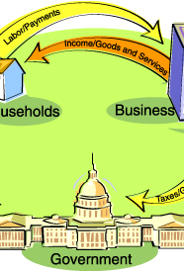
Session 1
How the Economic Machine Works
Cette photo par Auteur inconnu est soumise à la licence CC BY-SA

Slide 3
The Basic Economic Engine (Households & Firms)
01

Slide 4
Session Goals
Build a mental map of the economy using the circular flow model.
Understand the core transaction-based nature of economic activity.
Grasp the key drivers of long-term growth and short-term cycles.
Deconstruct GDP into its core components from a managerial perspective.

Slide 5
Agenda: Building our Model
The Core Engine: Households, Firms, and the two markets (Goods & Factor).
Adding the Government: Fiscal Policy (G & T).
Introducing the Financial Core: Saving, Investment, and the Central Bank.
Opening the Economy: Trade (NX) and Capital Flows (CF).
The Manager's Toolkit: Using IS-LM to analyze policy shocks.

Slide 6
The Economic Machine: Core Ideas (Dalio)
The economy is the sum of all its transactions.
A transaction: A buyer exchanges money or credit for goods, services, or financial assets.
Three main forces drive the economy:
  Productivity Growth (The long-run trend).
  Short-Term Debt Cycle (5-8 year business cycles).
  Long-Term Debt Cycle (75-100 year deleveraging).
Credit is the most important and volatile part of the economy.

Slide 7
The Core Engine: The Circular Flow
Our model starts with two actors (Households, Firms) and two markets (Goods, Factors).
Households: Supply labor/capital, earn income, and buy goods/services.
Firms: Hire labor/capital, produce goods/services, and pay income.
This creates two flows: a flow of real things (labor, goods) and a flow of money (wages, revenue).

Slide 8
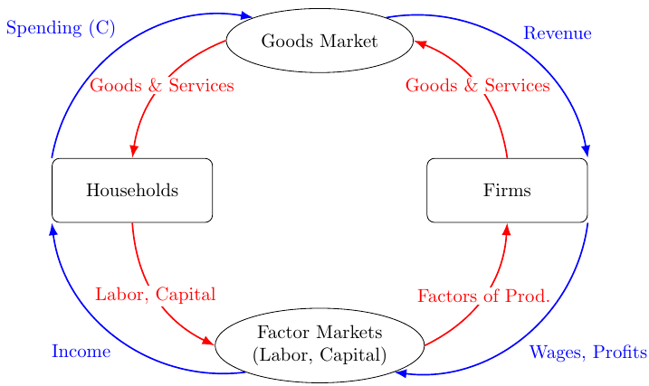
Diagram: The Basic Circular Flow

Slide 9
GDP: Measuring the Flow
Gross Domestic Product (GDP) is the total value of the money flow (or the goods flow).
The expenditure approach is most useful for managers. For our simple model:
  $Y=C+I$
C (Consumption): Household spending on goods and services.
I (Investment): Firm spending on capital, equipment, and inventories.

Slide 10
Adding the Government (Fiscal Policy)
02

Slide 11
Expanding the Model: The Public Sector
The government injects spending and withdraws taxes.
G (Government Spending): Purchases goods/services (e.g., infrastructure, defense). This is a direct injection into the Goods Market.
T (Taxes): Withdrawals from household income and firm profits.
Fiscal Policy: The government's decisions on G and T.
The GDP identity now becomes:
  $Y=C\left(Y−T\right)+I+G$

Slide 12
Fiscal Policy in Action
Expansionary Fiscal Policy ($↑G$ or $↓T$): Aims to increase total spending (aggregate demand) and boost Y. Managerial impact: higher demand for products, but potential for "crowding out" if government borrowing raises interest rates.
Contractionary Fiscal Policy ($↓G$ or $↑T$): Aims to reduce total spending, often to fight inflation. Managerial impact: lower demand, potential for lower interest rates.

Slide 13
The Financial Core (Monetary Policy)
03

Slide 14
Expanding the Model: Financial Markets
We need a system to channel money from savers to borrowers. This is the financial system.
Saving (S): Households don't spend all their income. The rest is saved. $S=Y−C−G$.
Financial Markets: Take household savings (and foreign capital) and lend it to firms for investment (I) and to the government to finance deficits.
In a closed economy, by definition: Saving = Investment ($S=I$).

Slide 15
The Central Bank and Interest Rates
The Central Bank (e.g., the Fed, ECB) is the manager of the financial system.
It controls the Money Supply (M) and influences the key price in this market: the interest rate (r).
Monetary Policy: The central bank's actions to manage M and r to achieve its goals (e.g., stable prices, max employment).
Fisher Relation: Connects nominal and real rates: $i≈r+𝔼\left[π\right]$. Managers must use this to distinguish real returns from inflation effects.

Slide 16
Monetary Policy in Action
Expansionary Monetary Policy ($↑M→↓r$): Aims to encourage firms to invest (I) and households to consume (C). Managerial impact: lower cost of capital, making more projects profitable.
Contractionary Monetary Policy ($↓M→↑r$): Aims to discourage spending to fight inflation. Managerial impact: higher cost of capital, reduced investment, and lower demand.

Slide 17
Opening the Economy (Trade & Global Capital)
04

Slide 18
Expanding the Model: The Rest of the World
Modern economies are open. We trade goods and capital globally.
NX (Net Exports): Exports (foreign spending on our goods) minus Imports (our spending on foreign goods). This is the "trade balance".
CF (Net Capital Outflow): The net flow of money for investment purposes. If positive, we are lending to the world. If negative, we are borrowing from the world.
The full GDP identity:
  $Y=C+I+G+NX$
The two flows are linked: NX must equal CF. A trade deficit ($NX<0$) must be financed by a capital inflow ($CF<0$).

Slide 19
The Exchange Rate (e)
The exchange rate (e) is the price that connects our economy to the world. It's the relative price of domestic vs. foreign goods/assets.
Appreciation ($↑e$): Our currency gets stronger. Makes our exports more expensive and imports cheaper. Tends to decrease NX.
Depreciation ($↓e$): Our currency gets weaker. Makes our exports cheaper and imports more expensive. Tends to increase NX.
Managerial Impact: FX exposure is a key risk for firms with international supply chains or sales.

Slide 20
A Manager's Toolkit for Policy Analysis (IS-LM)
05

Slide 21
Why Use a Model? IS-LM for Managers
The circular flow shows the pieces. IS-LM is a "mental map" to see how they interact.
It models the short-run relationship between the interest rate (r) and total output (Y).
It helps us analyze the full impact of a policy shock across all markets.

Slide 22
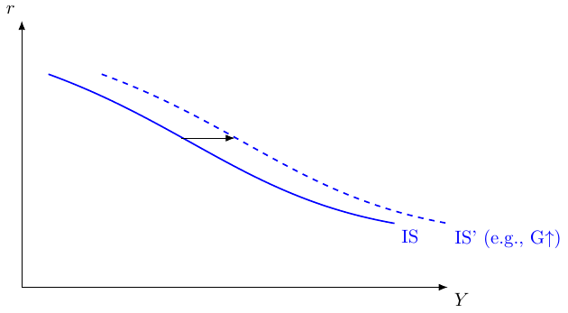
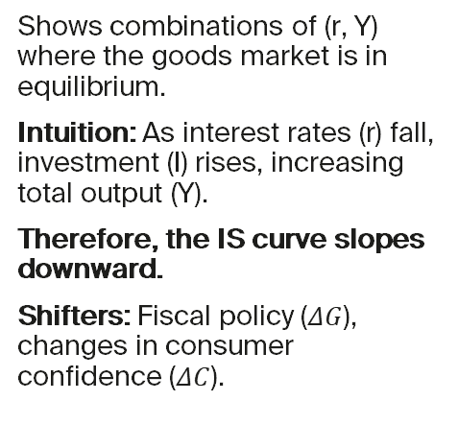
The IS Curve: Goods Market Balance
Shows combinations of (r, Y) where the goods market is in equilibrium.
Intuition: As interest rates (r) fall, investment (I) rises, increasing total output (Y).
Therefore, the IS curve slopes downward.
Shifters: Fiscal policy ($ΔG$), changes in consumer confidence ($ΔC$).

Slide 23
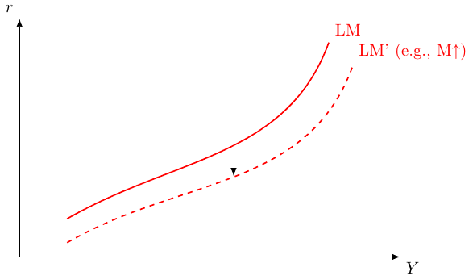
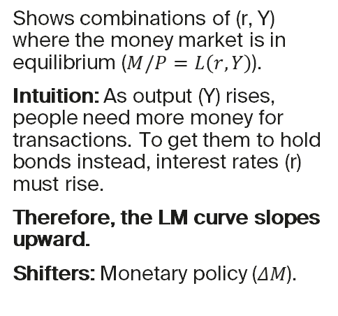
The LM Curve: Money Market Balance
Shows combinations of (r, Y) where the money market is in equilibrium ($M/P=L\left(r,Y\right)$).
Intuition: As output (Y) rises, people need more money for transactions. To get them to hold bonds instead, interest rates (r) must rise.
Therefore, the LM curve slopes upward.
Shifters: Monetary policy ($ΔM$).

Slide 24
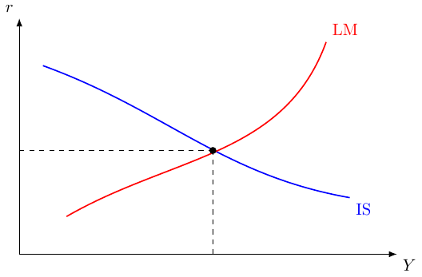
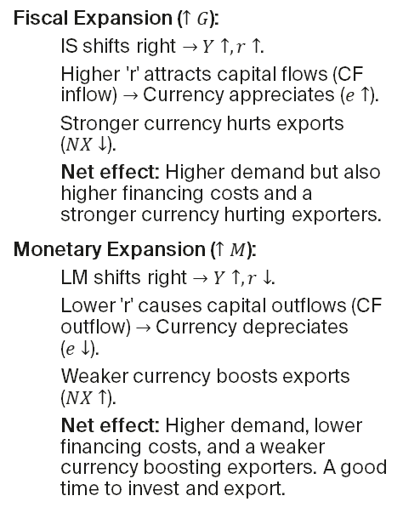
Putting It Together: Policy Scenarios
Fiscal Expansion ($↑G$):
  IS shifts right $→$ $Y↑,r↑$.
  Higher 'r' attracts capital flows (CF inflow) $→$ Currency appreciates ($e↑$).
  Stronger currency hurts exports ($NX↓$).
  Net effect: Higher demand but also higher financing costs and a stronger currency hurting exporters.
Monetary Expansion ($↑M$):
  LM shifts right $→$ $Y↑,r↓$.
  Lower 'r' causes capital outflows (CF outflow) $→$ Currency depreciates ($e↓$).
  Weaker currency boosts exports ($NX↑$).
  Net effect: Higher demand, lower financing costs, and a weaker currency boosting exporters. A good time to invest and export.

Slide 25
Managerial Applications & Summary
06

Slide 26
Using the Framework
This integrated framework helps you translate headlines into business strategy.
Pricing & Contracts: The interaction of policy and growth drives inflation ($π$). Your pricing power and need for indexation depend on this.
Capital Budgeting: Policy determines the interest rate (r), a key input for your WACC. Discount real cash flows with real rates. A monetary easing might be the trigger for a new project.
FX Exposure: The policy mix of your country vs. others determines the exchange rate (e). A fiscal expansion might appreciate the currency, requiring you to hedge your export revenues.
Demand Forecasting: The overall level of Y is your total addressable market. Watching C, I, G, and NX helps you anticipate demand shifts.

Slide 27
Key Takeaways
The economy is an interconnected system of flows (the Circular Flow Model).
Your firm's revenues are a piece of $C+I+G+NX$.
Fiscal policy ($ΔG,ΔT$) directly impacts demand but also interest rates.
Monetary policy ($ΔM$) impacts interest rates, which drives investment and the exchange rate.
The IS-LM model is your toolkit for thinking through the chain reaction of any economic shock.

