Slide 1
Session 2: Policy, Finance and Managerial Decisions
Nima Fazeli

Slide 2
Introduction

Slide 3
The Missing Link: Saving and Investment
In last session, The Campusville exercise, there was a crucial identity:
Households earned $130,000 in total income (wages + rent + profits).
They consumed $120,000 in coffee.
Their Saving (S) was $10,000.
Campus Coffee's Investment (I) in a new machine was also $10,000.
This is not a coincidence. It's a fundamental identity: Saving = Investment.
The flow of savings from households is what provides the funds for firms to invest. This happens through the financial markets.

Slide 4
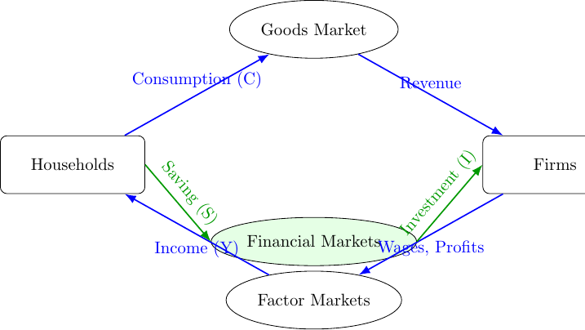
The Circular Flow with Financial Markets
Let's add the financial system to our map. It acts as an intermediary, channeling household savings to firms for investment and to the government to finance deficits.

Slide 5
Part 1: The Financial Markets and Monetary Policy

Slide 6
Expanding the Model: Financial Markets
Recall that the households are the ultimate owners of factors of production (labor, capital).
Also, recall that households don't spend all their income. The rest is saved.
And firms need capital to run their businesses.

Slide 7
Expanding the Model: Financial Markets
We need a system to channel money from savers to borrowers. This is the financial system.
Saving (S): Households don't spend all their income. The rest is saved. $S=Y−C−G$.
Financial Markets: Take household savings (and foreign capital) and lend it to firms for investment (I) and to the government to finance deficits.
In a closed economy, by definition: Saving = Investment ($S=I$).

Slide 8
The Central Bank and Interest Rates
The Central Bank (e.g., the Fed, ECB) is the manager of the financial system.
It controls the Money Supply (M) and influences the key price in this market: the interest rate (r).
Monetary Policy: The central bank's actions to manage M and r to achieve its goals (e.g., stable prices, max employment).
Fisher Relation: Connects nominal and real rates: $i≈r+𝔼\left[π\right]$.
  where $i$ is the nominal interest rate,
  $r$ is the real interest rate,
  $𝔼\left[π\right]$ is the expected inflation rate.
Managers must use this to distinguish real returns from inflation effects.

Slide 9
Monetary Policy in Action
Expansionary Monetary Policy ($↑M→↓r$): Aims to encourage firms to invest (I) and households to consume (C). Managerial impact: lower cost of capital, making more projects profitable.
Contractionary Monetary Policy ($↓M→↑r$): Aims to discourage spending to fight inflation. Managerial impact: higher cost of capital, reduced investment, and lower demand.

Slide 10
Monetary Policy in Action
How does the central bank change the money supply (M)?
By buying/selling government bonds in the open market (Open Market Operations).
By changing the reserve requirements for banks (less common).
By changing the discount rate at which banks can borrow from the central bank (less common).
Note that monetary policy primarily influences the short-term nominal interest rate (i), which in turn affects real rates (r) and economic activity.
In the long run, real rates are determined by real factors like productivity of capital and time preferences for consumption vs. saving.

Slide 11
Part 2: Adding the Government (Fiscal Policy)

Slide 12
Fiscal Policy in Action
Expansionary Fiscal Policy ($↑G$ or $↓T$): Aims to increase total spending (aggregate demand) and boost Y. Managerial impact: higher demand for products, but potential for "crowding out" if government borrowing raises interest rates.
Contractionary Fiscal Policy ($↓G$ or $↑T$): Aims to reduce total spending, often to fight inflation. Managerial impact: lower demand, potential for lower interest rates.

Slide 13
Fiscal Policy in Action: Government Budget
A government budget can be in surplus or deficit.
Budget Deficit: When $G>T$. The government needs to borrow, increasing demand for loanable funds, which can raise interest rates (crowding out private investment).
Budget Surplus: When $G<T$. The government is a net saver, which can lower interest rates and free up funds for private investment.

Slide 14
Fiscal Policy in Action: Government Budget
How does the government finance a deficit?
If $G>T$, the government borrows the difference $\left(G−T\right)$. This is done in two main ways:
By issuing bonds, which households and firms can buy.
By borrowing from the central bank (monetizing the debt), which can lead to inflation if overused. This is less common in developed economies as it can undermine confidence in the currency.

Slide 15
CASE Tackling a Slowdown
Case study - Fiscal Policy and Tackling a recession

Slide 16
Part 3: Reading the Data

Slide 17
The Big Three Indicators for Managers
Policy is driven by data. A savvy manager tracks a few key indicators to anticipate policy shifts and understand the business environment. We can build this dashboard right here.
GDP Growth: Is the overall economic pie growing or shrinking? This is the primary driver of your total addressable market.
Unemployment: How tight is the labor market? This affects wage pressure (costs) and consumer confidence (demand).
Inflation: Are prices stable? This drives input costs, pricing power, and, critically, the central bank's reaction function.

Slide 18
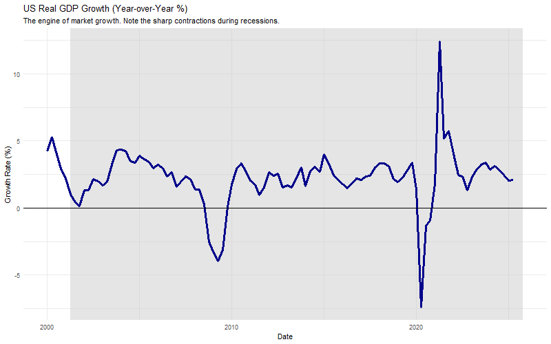
Seeing the Data 1: Real GDP Growth
Let's pull the data for US Real GDP growth. Shaded areas indicate recessions.

Slide 19
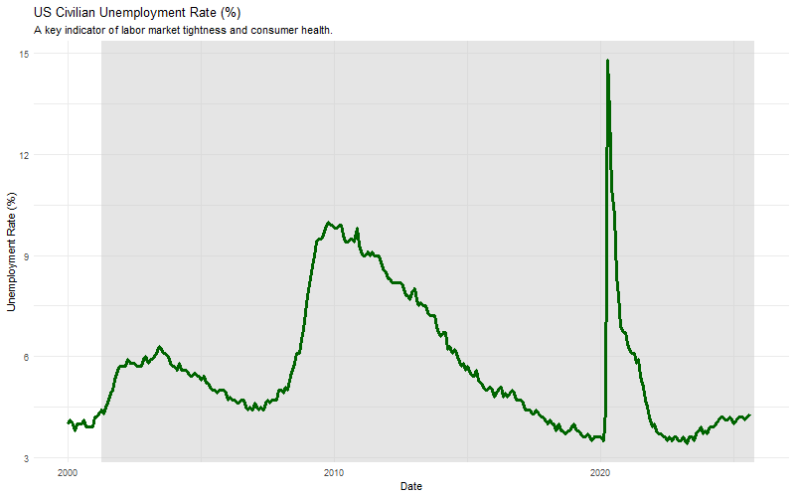
Seeing the Data 2: The Unemployment Rate
A low unemployment rate is good for workers but can signal rising wage costs for managers and inflation concerns for the Fed.

Slide 20
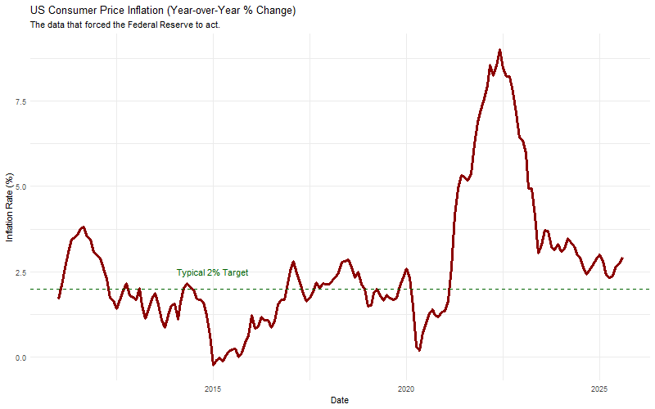
Seeing the Data: The Recent Inflation Spike (US Example)
Policy is driven by data. Let's look at the inflation data that triggered the aggressive rate hikes we discussed. We can pull this directly from the source (the FRED database) using R.

Slide 21
This chart shows why central bankers became so concerned. As a manager, seeing inflation move this far from the target is a clear signal that borrowing costs are about to rise significantly.

Slide 22
Part 4: Opening the Economy (Trade & Global Capital)

Slide 23
Expanding the Model: The Rest of the World
Modern economies are open. We trade goods and capital globally.
NX (Net Exports): Exports (foreign spending on our goods) minus Imports (our spending on foreign goods). This is the "trade balance".
CF (Net Capital Outflow): The net flow of money for investment purposes. If positive, we are lending to the world. If negative, we are borrowing from the world.
The full GDP identity:
  $Y=C+I+G+NX$
The two flows are linked: NX must equal CF. A trade deficit ($NX<0$) must be financed by a capital inflow ($CF<0$).

Slide 24
The Exchange Rate (e)
The exchange rate (e) is the price that connects our economy to the world. It's the relative price of domestic vs. foreign goods/assets.
Appreciation ($↑e$): Our currency gets stronger. Makes our exports more expensive and imports cheaper. Tends to decrease NX.
Depreciation ($↓e$): Our currency gets weaker. Makes our exports cheaper and imports more expensive. Tends to increase NX.
Managerial Impact: FX exposure is a key risk for firms with international supply chains or sales.

Slide 25
Part 5: Putting it all together in IS-LM model

Slide 26
Using the IS-LM Framework: A Manager's Checklist
The IS-LM model isn't just theory. It's a structured way to turn a headline ("Fed Raises Rates") into a strategic action plan.
Capital Budgeting (NPV & IRR):
  Watch the LM curve. Monetary policy ($ΔM$) directly hits the interest rate (r), which is the foundation of your WACC.
  Action: Re-run NPV analysis on major projects after a significant monetary policy shift. An expansionary policy (LM shifts right, r $↓$) might turn a borderline project into a "Go."

Slide 27
Using the IS-LM Framework: A Manager's Checklist
Demand Forecasting (Sales & Revenue):
  Watch the IS curve. Fiscal policy ($ΔG,ΔT$) and consumer confidence directly impact aggregate demand (Y), your total market size.
  Action: Adjust sales forecasts up during a fiscal expansion (IS shifts right, Y $↑$). Be wary of "crowding out" if rates (r $↑$) also rise.

Slide 28
Using the IS-LM Framework: A Manager's Checklist
FX Risk Management (Global Operations):
  The model predicts the capital flows that drive the exchange rate (e).
  Fiscal Expansion ($↑G⇒↑r$): Expect capital inflows and a stronger currency. Your export revenues are at risk.
  Monetary Expansion ($↑M⇒↓r$): Expect capital outflows and a weaker currency. Your export revenues will benefit, but import costs will rise.
  Action: Review your hedging strategy based on the anticipated policy mix.

Slide 29
Using the IS-LM Framework: A Manager's Checklist
Strategic Planning (Scenario Analysis):
  Use the IS-LM framework to game out different scenarios, like in our "Stagflation Scare" workshop.
  Action: Build best-case (e.g., Monetary easing + Fiscal stability) and worst-case (e.g., Monetary tightening + Fiscal contraction) scenarios to stress-test your strategy.

Slide 30
Session 2 Key Takeaways
The economy is an interconnected system of goods and financial markets. Your firm operates in both.
Your core dashboard should track GDP growth (market size), unemployment (labor costs/demand), and inflation (input costs/policy trigger).
Fiscal policy ($ΔG,ΔT$) shifts the IS curve, primarily affecting aggregate demand (Y).
Monetary policy ($ΔM$) shifts the LM curve, primarily affecting interest rates (r).
The IS-LM model gives you a powerful mental map to trace the ripple effects of any policy shock on your revenue (Y), cost of capital (r), and global competitiveness (e) in the short-run.

