Slide 1
Session 3: The Corporation & Value Creation
Nima Fazeli

Slide 2
Part 0: A Refresher on Financial Statements

Slide 3
The Language of Business: An Introduction
Before we can calculate cash flow or value, we need to understand the language companies use to report their performance: the financial statements.
They are the scorecard of the business.
They allow us to answer fundamental questions about profitability, solvency, and cash generation.
There are three core statements that work together:
Income Statement: A movie of performance over a period.
Balance Sheet: A snapshot of financial health at a point in time.
Statement of Cash Flows: The story of how cash changed from the beginning to the end of the period.

Slide 4
The Balance Sheet: A Snapshot in Time
Uses of Funds (What the Firm Owns) | Sources of Funds (How it's Paid For)
Assets | Liabilities & Equity
Current Assets | Current Liabilities
- Cash | - Accounts Payable
- Accounts Receivable | - Short-term Debt
- Inventory
Non-Current Assets | Non-Current Liabilities
- Property, Plant & Equipment (PP&E) | - Long-term Debt
- Intangible Assets (Goodwill) | Shareholders' Equity
 | - Common Stock
 | - Retained Earnings
Total Assets | Total Liabilities & Equity
The Balance Sheet presents a company's financial position at a single point in time. It's governed by a fundamental equation:
Assets = Liabilities + Shareholders' Equity
Managerial Insight: This shows a firm's investment decisions (Assets) versus its financing decisions (Liabilities & Equity).

Slide 5
The Income Statement: A Story Over a Period
Component | Description
Revenue (Sales) | Total amount of goods/services sold.
- Cost of Goods Sold (COGS) | Direct costs of producing the goods sold.
= Gross Profit | Profitability from core production.
- Operating Expenses (SG&A, R&D) | Indirect costs of running the business.
- Depreciation & Amortization (D&A) | Non-cash expense for the "using up" of assets.
= Operating Income (EBIT) | The key measure of core business profitability.
- Interest Expense | Cost of debt financing.
= Earnings Before Tax (EBT)
- Taxes
= Net Income | The "bottom line." Note: This is NOT the same as cash!
The Income Statement reports a company's financial performance over a specific period (e.g., a quarter or a year). It shows revenues, expenses, and the resulting profit or loss.

Slide 6
The Statement of Cash Flows: Following the Money
This statement reconciles the Net Income from the Income Statement with the actual change in cash on the Balance Sheet. It's the most objective view of a company's health.
It is broken into three sections:
Cash Flow from Operations (CFO):
Starts with Net Income.
Adds back non-cash expenses (like Depreciation).
Adjusts for changes in Net Working Capital (e.g., if receivables go up, that's a use of cash).
This is the cash generated by the core business.
Cash Flow from Investing (CFI):
Shows cash used for investments.
Primarily Capital Expenditures (buying new PP&E).
Also includes acquisitions or sales of assets.
This shows the firm's growth strategy.
Cash Flow from Financing (CFF):
Shows how the firm raises or returns capital.
Includes issuing new debt or stock (+), repaying debt (-), paying dividends (-), or buying back stock (-).
This shows the firm's financing strategy.

Slide 7
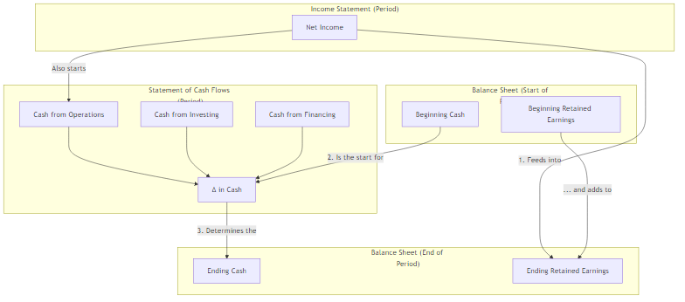
How They All Fit Together

Slide 8
How They All Fit Together
Net Income from the Income Statement, less any dividends paid, is added to Retained Earnings on the Balance Sheet.
The Statement of Cash Flows starts with the beginning cash balance from the prior period's Balance Sheet.
The changes in Balance Sheet accounts (like PP&E or Inventory) are used to calculate cash flows from operations and investing.
The final Ending Cash balance on the Statement of Cash Flows must match the cash account on the current period's Balance Sheet.

Slide 9
From Statements to Strategy: What Managers Look For
This is not an accounting exercise. We use the statements to diagnose the business and make decisions.
Income Statement -> Profitability: Are our margins healthy? Is our pricing strategy working?
Balance Sheet -> Solvency & Efficiency: Do we have too much debt? Are we managing our inventory and receivables effectively (Net Working Capital)?
Statement of Cash Flows -> Cash Generation: Is the business actually generating cash from its operations (CFO)? Or are we surviving by taking on debt (CFF) or selling assets (CFI)?
This foundation is exactly what we need to calculate Free Cash Flow (FCF), our true measure of value creation, which we will tackle next.

Slide 10
Part 1: The Goal - What is the Firm For?

Slide 11
The Core Objective: Value Creation
From a finance perspective, the primary goal of management is to maximize the intrinsic value of the firm for its shareholders.
All decisions-hiring, marketing, capital spending, R&D-should ultimately be judged by this standard: Does this decision increase the value of the firm?
Our job today is to build the toolkit to measure this value.

Slide 12
The Universal Valuation Formula
At its heart, the value of any asset, including an entire company, is simple:
Value = The Present Value of all its future Cash Flows
$$\text{Value}=\frac{CF_{1}}{{\left(1+r\right)}^{1}}+\frac{CF_{2}}{{\left(1+r\right)}^{2}}+\frac{CF_{3}}{{\left(1+r\right)}^{3}}+…$$
The Manager's Levers:
Increase the size of future cash flows (CF).
Increase the growth rate of those cash flows.
Reduce the riskiness of those cash flows (which lowers the discount rate, r).
Our entire session is about defining and measuring CF (Cash Flow) and r (the discount rate).

Slide 13
Session Goals
Re-establish a common understanding of corporate finance fundamentals.
Master the calculation of Free Cash Flow (FCF), the true measure of economic performance.
Deconstruct the Weighted Average Cost of Capital (WACC) and see how it is driven by macro variables.
Connect FCF and WACC to build a Discounted Cash Flow (DCF) valuation.
Set the stage for the rest of the course: How do macro shocks (inflation, rates, etc.) impact FCF and WACC?

Slide 14
Part 2: Measuring Performance - Free Cash Flow (FCF)

Slide 15
Why FCF? Beyond Net Income
Net Income is an accounting measure. It can be misleading due to:
Non-cash expenses (e.g., Depreciation & Amortization).
Subjective accounting choices.
It ignores crucial cash investments in working capital and fixed assets.
Free Cash Flow (to the Firm) is the cash flow generated by the business that is available to all capital providers (both debt and equity holders).
It is the "real" cash profit of the company before financing decisions.

Slide 16
Calculating Free Cash Flow (to the Firm)
Component | Calculation
Start with Operating Profit (EBIT) | Revenues - COGS - Operating Expenses
Adjust for Taxes | EBIT * (1 - Tax Rate) = NOPAT
Add back non-cash charges | + Depreciation & Amortization (D&A)
Subtract investment in fixed assets | - Capital Expenditures (CapEx)
Subtract investment in working capital | - Change in Net Working Capital (Δ NWC)
Result = Free Cash Flow (FCF)
The standard formula starts from operating profit (EBIT):

Slide 17
Calculating Free Cash Flow (to the Firm)
Calculation | What it Means for Managers
Revenues - COGS - Operating Expenses | The core profitability of the business operations.
EBIT * (1 - Tax Rate) = NOPAT | The hypothetical after-tax profit if the firm had no debt.
+ Depreciation & Amortization (D&A) | Accounting expenses that aren't actual cash outflows.
- Capital Expenditures (CapEx) | Cash spent on new property, plant, and equipment for future growth.
- Change in Net Working Capital (Δ NWC) | Cash tied up in managing inventory, receivables, and payables.
 | The cash available to pay investors (debt and equity).
An expanded view with explanations

Slide 18
DISCUSSION FCF Calculation - A Simple Example
Global Corp - Income Statement
Revenue | $1,000
COGS | -$600
Gross Profit | $400
Operating Expenses | -$150
Depreciation | -$50
EBIT | $200
Interest Expense | -$20
EBT | $180
Taxes (30%) | -$54
Net Income | $126
Let's calculate FCF for a hypothetical company, "Global Corp."
Task: Calculate the Free Cash Flow for Global Corp.
Global Corp - Other Data
Capital Expenditures (CapEx) | $80
Change in Net Working Capital | $30

Slide 19
FCF Calculation - Solution
NOPAT = EBIT * (1 - T) = $200 * (1 - 0.30) = $140
Add back D&A = +$50
Subtract CapEx = -$80
Subtract $Δ NWC$ = -$30
$$\text{FCF}=\$140+\$50−\$80−\$30=\$80$$
Notice how different the FCF ($80) is from the Net Income ($126). This is the number we will use for valuation.

Slide 20
Part 3: Measuring Risk - The Cost of Capital (WACC)

Slide 21
What is WACC?
The Weighted Average Cost of Capital (WACC) is the average rate of return a company must pay to its investors (debt and equity holders).
It is the firm's overall cost of capital.
For managers, it is the hurdle rate for new projects. An investment is only worthwhile if its expected return is greater than the WACC.

Slide 22
The WACC Formula
It's a blend of the cost of equity and the after-tax cost of debt.
$$WACC=\left(\frac{E}{V}\right)⋅R_{e}+\left(\frac{D}{V}\right)⋅R_{d}⋅\left(1−T\right)$$
$R_{e}$ = Cost of Equity (the return shareholders require)
$R_{d}$ = Cost of Debt (the interest rate the firm pays on its debt)
$E$ = Market Value of Equity
$D$ = Market Value of Debt
$V=E+D$ = Total Firm Value
$T$ = Corporate Tax Rate

Slide 23
DISCUSSION Deconstructing WACC: The Macro Connections
WACC Input | Formula (CAPM)
Cost of Equity (Re) | (R_{f} + β ⋅ (R_{m} - R_{f}))
…Risk-Free Rate (Rf)
…Beta (β)
…Market Premium (ERP)
Cost of Debt (Rd) | (R_{f} + Credit Spread)
Capital Structure | (E/V, D/V)
This is the single most important bridge from macroeconomics to corporate finance. Where do the numbers come from?
The WACC is not a static plug-in number. It is a live, breathing variable that changes with the macroeconomic environment.

Slide 24
DISCUSSION Deconstructing WACC: The Macro Connections
WACC Input | Comes From…
Cost of Equity (Re)
…Risk-Free Rate (R_{f}) | Government bond yield (e.g., 10-year Treasury)
…Beta (β) | Statistical measure of stock's volatility vs. market
…Market Premium (ERP) | Historical excess return of stocks over bonds
Cost of Debt (Rd) | Yield on the company's bonds (or comparable bonds)
Capital Structure | Firm's financing decisions and market value fluctuations.
This is the single most important bridge from macroeconomics to corporate finance. Where do the numbers come from?
The WACC is not a static plug-in number. It is a live, breathing variable that changes with the macroeconomic environment.

Slide 25
DISCUSSION Deconstructing WACC: The Macro Connections
WACC Input | Macro Link (from Sessions 1 & 2)
Cost of Equity (Re)
…Risk-Free Rate (R_{f}) | Interest Rates (r) set by the Central Bank.
…Beta (β) | Business cyclicality. High-beta firms are sensitive to GDP (Y).
…Market Premium (ERP) | Overall economic risk appetite, investor fear/greed.
Cost of Debt (Rd) | Interest Rates (r) + market perception of default risk.
Capital Structure | Influenced by credit conditions and firm strategy.
This is the single most important bridge from macroeconomics to corporate finance. Where do the numbers come from?
The WACC is not a static plug-in number. It is a live, breathing variable that changes with the macroeconomic environment.

Slide 26
Part 4: Putting It All Together - Valuation

Slide 27
The DCF Valuation Model
Now we combine FCF and WACC.
$$\text{Firm} \text{Value}=\sum_{t=1}^{n}{\frac{{\text{FCF}}_{t}}{{\left(1+\text{WACC}\right)}^{t}}}+\frac{{\text{Terminal} \text{Value}}_{n}}{{\left(1+\text{WACC}\right)}^{n}}$$
We forecast FCF for a specific period (e.g., 5-10 years).
We then estimate a Terminal Value to capture the value of all cash flows beyond the forecast period.
A common way to calculate Terminal Value is the Gordon Growth Model:
${\text{Terminal} \text{Value}}_{n}=\frac{{\text{FCF}}_{n+1}}{\text{WACC}−g}$
Where g is the perpetual growth rate of FCF. A critical assumption!
Macro Link: g cannot plausibly be higher than the long-run growth rate of the economy (Nominal GDP).

Slide 28
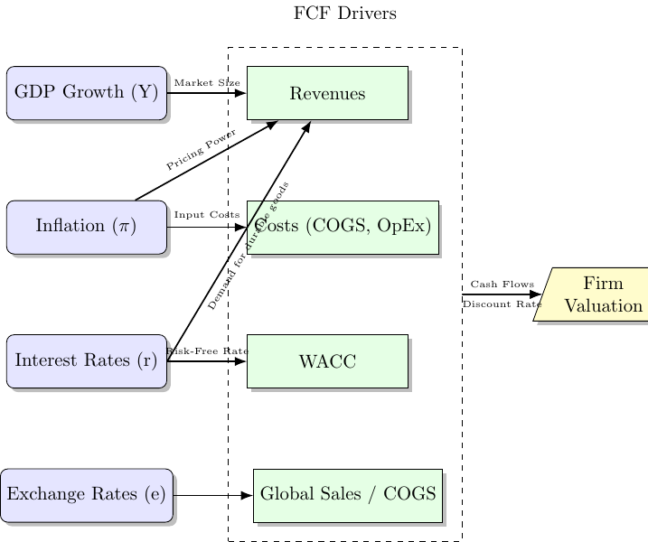
CASE The Macro-to-Value Framework
Let's visualize how the macro world flows through to a company's valuation. We can build this map. This map is our guide for the rest of the course.

Slide 29
Part 5: Application & Wrap-Up

Slide 30
EXERCISE Mini-Case: The WACC Shock (15 min)
Your firm, "SteadyCo," has the following profile:
It generates a stable FCF of $100 million per year, forever (i.e., it's a perpetuity, g=0).
Its current WACC is 8%.
Tasks:
What is the current value of SteadyCo? (Hint: Value of a perpetuity = FCF / WACC)
The Central Bank makes a surprise announcement, and you expect this will cause your company's WACC to increase from 8% to 10%. What is the new value of your firm?
What is the percentage change in the firm's value from this 2% WACC increase?
As a manager, what does this tell you about the sensitivity of your company's value to monetary policy?

Slide 31
Key Takeaways for Session 3
FCF is the measure of truth. It represents the cash a firm generates for its investors.
WACC is the bridge from macro to finance. It is the risk-adjusted hurdle rate, and its components (especially the risk-free rate) are directly tied to the economic environment.
Valuation is a function of both FCF and WACC. A manager can create value by boosting FCF or by de-risking the firm (which lowers WACC).
You now have a complete, though simplified, framework to trace a headline like "Central Bank Raises Rates" all the way down to a change in your firm's stock price. This is the skill we will build on.

