Slide 1
Session 4: Macro to Value - Linking the Economy to Firm Decisions
Nima Fazeli

Slide 2
Part 1: The Core Connection - From Headlines to Valuation

Slide 3
Session 4 Goals
Build the definitive bridge from macro variables (Y, π, r) to firm valuation.
Analyze precisely how economic shocks transmit to a company's Free Cash Flows (FCF).
Analyze precisely how those same shocks transmit to the Weighted Average Cost of Capital (WACC).
Introduce a practical framework (the "Macro-to-Value Map") to use in your final project.
Kick off the final project and form groups.

Slide 4
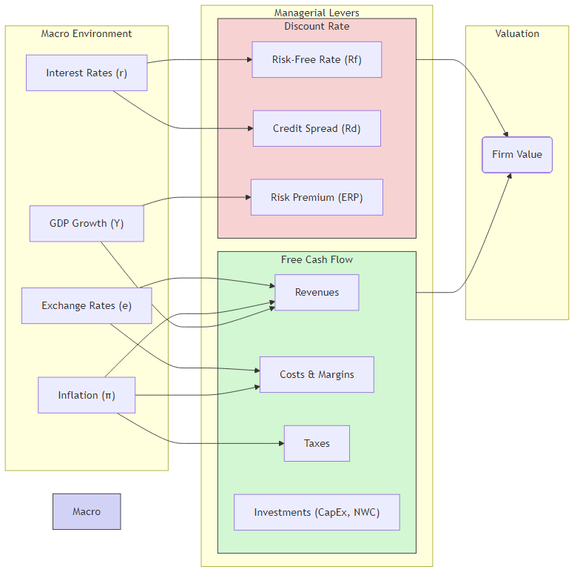
The Bridge from Macro to Value
Our goal today is to connect the two worlds we have discussed. We move from analyzing the economy to making decisions for the firm. The connection happens through the two levers of valuation we learned about in Session 3.

Slide 5
Recall: The Universal Valuation Formula
Everything comes back to this. To change the value of the firm, a manager must influence one of two things: the future cash flows or the rate at which they are discounted. Today, we see how the macro environment influences both.
$$\text{Value}=\sum_{t=1}^{n}{\frac{{\text{FCF}}_{t}}{{\left(1+\text{WACC}\right)}^{t}}}+\frac{{\text{Terminal} \text{Value}}_{n}}{{\left(1+\text{WACC}\right)}^{n}}$$
Our job is to trace the impact of a headline like "Inflation at 40-year high" all the way down to the FCF and WACC in this formula.

Slide 6
Part 2: The Cash Flow Channel (The Numerator)

Slide 7
How Macro Drives Free Cash Flow (FCF)
FCF Component | Key Macro Driver(s) | The Managerial Question
Revenue | GDP Growth (Y), Inflation (π) | Is my market growing? Can I raise prices?
Costs (COGS, OpEx) | Inflation (π), Wages | Are my input costs and wages rising faster than my prices?
Taxes | Tax Policy, Inflation (π) | How does inflation create "phantom profits" that get taxed?
Investment (CapEx, NWC) | GDP Growth (Y), Rates (r) | Do I need to invest more to support growth? What's the cost?
Let's break down FCF and trace the impact of macro variables on each component.

Slide 8
1. The Revenue Channel: Growth and Pricing
GDP Growth (Y): This is the primary driver of market size. For cyclical firms (e.g., automakers, construction), revenue growth is tightly correlated with GDP growth. Your sales forecast must start with a GDP forecast.
Inflation (π): This is the driver of nominal revenue growth. Inflation provides "air cover" to raise prices. The key question is whether a firm has *pricing power*—the ability to raise prices without losing significant volume.

Slide 9
2. The Cost Channel: Margins Under Pressure
Input Costs (PPI, Commodities): Inflation is not uniform. The Producer Price Index (PPI) often leads the CPI. A rising PPI signals that your COGS are about to increase. Volatile commodity prices (oil, copper) are also a direct hit to margins for many industries.
Wage Pressures (Unemployment): A tight labor market (low unemployment) forces firms to increase wages to attract and retain talent. This directly impacts Operating Expenses (OpEx).
The Margin Squeeze: The battle for profitability is fought here: `Margin = f(Pricing Power, Cost Control)`.

Slide 10
3. The Tax Channel: Inflation's Hidden Bite
Inflation can increase a firm's tax bill even if its real profitability hasn't changed. This is a crucial, often overlooked, impact.
Depreciation Tax Shield: Depreciation is based on the historical cost of assets. In an inflationary environment, the real value of that tax deduction shrinks over time. The cost to replace the asset in the future will be much higher, but your tax benefit is fixed.
Inventory valuation (FIFO vs. LIFO): With First-In, First-Out (FIFO) accounting, during a period of rising prices, you sell your "cheaper" older inventory, creating higher accounting profit (and a higher tax bill) than is economically real. This is a "phantom profit."

Slide 11
4. The Investment Channel (CapEx & NWC)
Net Working Capital (ΔNWC): Growth requires more working capital. As your revenues (driven by Y and π) grow, you need to fund more inventory and receivables. This is a cash outflow that reduces FCF. High inflation can dramatically inflate the amount of cash tied up in NWC.
Capital Expenditures (CapEx): To grow, firms must invest. The decision to invest depends on the expected demand (Y) and the cost of funding that investment (r). Even if a firm just maintains its capital stock, inflation means the nominal cost of replacing old equipment (CapEx) will be higher each year.

Slide 12
Part 3: The Risk Channel (The Denominator)

Slide 13
How Macro Drives the Discount Rate (WACC)
WACC Input | Formula (CAPM) | Comes From… | Direct Macro Link
Cost of Equity (Re) | (R_{f} + β ⋅ (R_{m} - R_{f}))
…Risk-Free Rate (Rf) |  | Government bond yield (e.g., 10-year Treasury) | Interest Rates (r) set by Monetary Policy.
…Beta (β) |  | Stock's volatility vs. market | Business cyclicality. High-beta firms are sensitive to GDP (Y).
…Market Premium (ERP) |  | Historical excess return of stocks over bonds | Overall economic risk appetite, driven by growth & uncertainty.
Cost of Debt (Rd) | (R_{f} + Credit Spread) | Yield on the company's bonds | Interest Rates (r) + market fear of default (credit cycle).
The WACC is not a static number from a textbook. It is a live market price that reflects the current economic risk environment. Let's revisit the WACC components from Session 3.

Slide 14
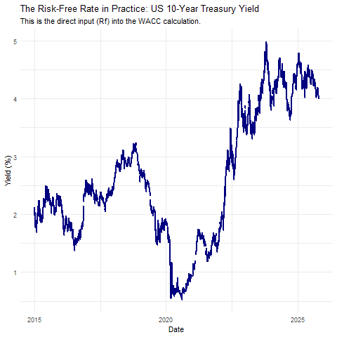
Live Data: The Risk-Free Rate (Rf)
The foundation of the entire WACC calculation is the risk-free rate. This is not a theoretical concept; it's the current yield on a government bond. When the central bank hikes rates, this is the first number that changes.

Slide 15
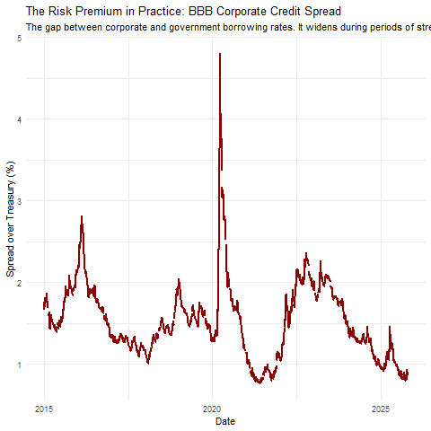
Live Data: The Credit Spread
The Cost of Debt (Rd) is not just the risk-free rate; it's $R_{f}+\text{Credit} \text{Spread}$. The spread is the market's assessment of the company's default risk. In a recession, fear rises, spreads widen, and the WACC increases, even if the central bank is cutting $R_{f}$.

Slide 16
Part 4: Application & Project Kickoff

Slide 17
EXERCISE The Inflation Impact Mini-Case (20 min)
You are the manager of "Global Manufacturing Inc." The company is facing a sudden inflation shock.
Your task is to calculate the impact on profit margins.
Work in your groups and discuss the strategic implications.

Slide 18
EXERCISE The Inflation Impact Mini-Case (20 min)
 | Base Case | Inflation Shock
Revenue | $1,000 | +10% (You have some pricing power)
COGS (Variable) | -$500 (50% of Rev) | Inputs rise by 20%
OpEx (Fixed) | -$300 | Rises by 5% (salaries, rent)
Operating Profit (EBIT) | $200 | Calculate This
Operating Margin | 20% | Calculate This
Global Manufacturing Inc. - Income Statement Under Inflation Shock

Slide 19
EXERCISE The Inflation Impact Mini-Case (20 min)
Questions for your group:
Calculate the new EBIT and Operating Margin under the "Inflation Shock."
What happened to the company's profitability? Why?
As a manager, what are your top 3 priorities to address this situation?

Slide 20
DISCUSSION The Inflation Impact Mini-Case - Discussion
The Calculation:
New Revenue = $1,000 * 1.10 = $1,100
New COGS = $500 * 1.20 = $600
New OpEx = $300 * 1.05 = $315
New EBIT = $1,100 - $600 - $315 = $185
New Margin = $185 / $1,100 = 16.8%

Slide 21
DISCUSSION The Inflation Impact Mini-Case - Discussion
Key Takeaway: Even with good pricing power (passing on 10% price increases), the firm's margin was squeezed from 20% to 16.8%. This is because cost inflation outpaced price increases.
Managerial Priorities:
Pricing: Can we raise prices further? What will competitors do?
Cost Cutting: Can we find cheaper suppliers? Can we improve efficiency?
Communication: How do we explain this to investors in the next earnings call?

Slide 22
KICKOFF: Your Final Project
The goal of your final project is to apply the "Macro-to-Value" framework to a real, publicly traded company.
Objective: Analyze how the macroeconomic environment impacts your chosen company's valuation and recommend strategic actions.
Teams: Form groups of 3-4.
Key Steps:
Select a Company: Choose a firm with interesting macro exposure (e.g., a cyclical industrial, a global consumer brand, a commodity producer).
Build the Macro-to-Value Map: Identify the key macro variables that drive the firm's FCF and WACC.
Analyze & Forecast: Gather data and build a base-case valuation.
Develop Scenarios: Create 2-3 plausible alternative macro scenarios (e.g., "Hard Landing," "Stagflation," "Soft Landing").
Recommend Actions: What should management do now to prepare for these scenarios? (e.g., change capital structure, hedge FX, cut capex).

Slide 23
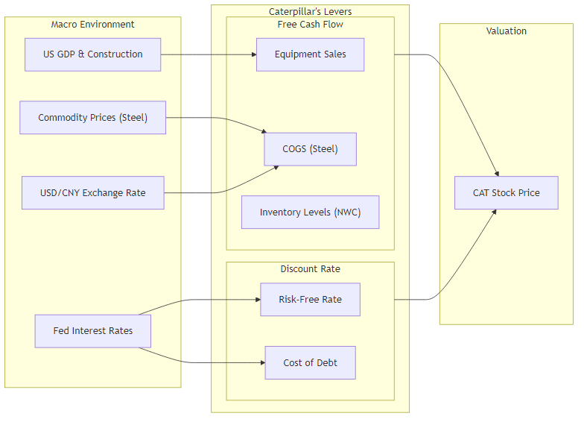
Project Idea: Start with a "Macro-to-Value Map"
For your chosen company, your first step should be to create a specific version of the chart we saw earlier. This will be the blueprint for your entire analysis.

Slide 24
Part 5: Wrap-Up

Slide 25
Session 4 Key Takeaways
Macro is Not Abstract: Economic events have a direct, quantifiable impact on firm value through the two channels of Free Cash Flow (FCF) and the Cost of Capital (WACC).
Inflation is a Double-Edged Sword: It can boost nominal revenues but can severely compress margins if costs rise faster. It also has hidden tax effects. The winner is the firm with pricing power.
WACC is a Live Variable: The discount rate is not fixed. It moves with central bank policy and market risk perceptions. A 1% change in WACC can have a massive impact on valuation.
The Macro-to-Value Map is Your Tool: This framework is your guide for analyzing any company and for structuring your final project. Use it to organize your thoughts and analysis.

