Slide 1
Session 5: Navigating Global Economic & Political Risk
Nima Fazeli

Slide 2
Part 1: The Global Manager's Dilemma

Slide 3
Reminders & Session 5 Goals
Reminder: Your Group Case Write-up is due at the beginning of this session.
Today's Goals:
Identify and measure Foreign Exchange (FX) Risk and its impact on your company's P&L.
Understand basic hedging strategies as a tool to mitigate FX risk.
Define Geopolitical Risk and see how it is incorporated into valuation via the Country Risk Premium (CRP).
Analyze the strategic shift from "Just-in-Time" to "Just-in-Case" supply chains in response to global uncertainty.

Slide 4
The Shift: From Globalization to a Fragmented World
The "Old World" (c. 1990-2015) | The "New World" (Today)
Assumption: Ever-increasing free trade. | Reality: Trade wars, tariffs, sanctions.
Goal: Efficiency, cost minimization. | Goal: Resilience, security of supply.
Strategy: "Just-in-Time" supply chains. | Strategy: "Just-in-Case," on-shoring, friend-shoring.
Key Risk: Economic cycle. | Key Risks: Geopolitical, pandemic, climate.
The assumptions that underpinned global business strategy for 30 years are changing.
As a manager, you must operate in the new reality. Today, we build the toolkit for it.

Slide 5
Part 2: Foreign Exchange (FX) Risk - The P&L Impact

Slide 6
What is FX Risk?
For a manager, it's the risk that exchange rate movements will negatively impact your company's profits and cash flows.
There are three main types, but we'll focus on the most direct one:
Transaction Exposure: Risk on future cash flows from specific, contracted international transactions (e.g., you have a contract to sell goods in the US for $1M in 90 days).
Translation Exposure: "Accounting risk" that arises when converting foreign subsidiaries' financial statements back to the parent company's home currency.
Economic Exposure: Long-term risk that exchange rate movements will affect a firm's competitive position and future cash flows.

Slide 7
An Example: French Company, US Sales
You are a French company (home currency EUR) that just sold goods to a US client.
The client will pay you US$1,000,000 in 3 months.
The current exchange rate is €0.90 per $1. You expect to receive €900,000.

Slide 8
An Intuitive Example: French Company, US Sales
Scenario | Exchange Rate | Received in EUR | Impact on your P&L
Baseline | €0.90 / $1 | €900,000 | The expected amount.
Scenario A: Dollar weakens | €0.80 / $1 | €800,000 | Loss of €100,000! Bad.
Scenario B: Dollar strengthens | €1.00 / $1 | €1,000,000 | Gain of €100,000! Good.
Your company's revenue in Euros is volatile, even if you sell the exact same amount in dollars.

Slide 9
It Cuts Both Ways: The Importer's View
Scenario | Exchange Rate | Cost in EUR | Impact on your P&L
Baseline | €0.90 / $1 | €900,000 | The expected cost.
Scenario A: Dollar weakens | €0.80 / $1 | €800,000 | Saved €100,000! Good.
Scenario B: Dollar strengthens | €1.00 / $1 | €1,000,000 | Cost €100,000 more! Bad.
Now, assume your French company needs to buy a key component from the US for US$1,000,000.
A strong home currency is good for importers, bad for exporters. A weak home currency is bad for importers, good for exporters.

Slide 10
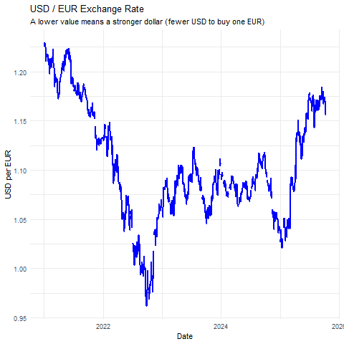
Live Data: The EUR/USD Rollercoaster
This isn't theoretical. Look at the recent volatility in the USD/EUR exchange rate. Imagine being a manager trying to forecast revenues or costs with this chart.

Slide 11
ACTIVITY The Global Manager's Dilemma
We will now work through the in-class activity found in PSBLearn
Using the live data and company profiles, your teams will assess the impact of these FX shifts on both revenues and costs.
This will make the two-sided nature of FX risk concrete.
See Class Activity: Global Manager's Dilemma

Slide 12
Part 3: Managing FX Risk - Hedging Strategies

Slide 13
To Hedge or Not to Hedge?
Hedging is the act of entering into a financial contract to protect against unexpected movements in an underlying asset (like a currency). It's a strategic decision.
The Argument FOR Hedging:
Reduces uncertainty and cash flow volatility.
Allows managers to focus on the core business, not currency speculation.
Improves predictability for budgeting and financial planning.
The Argument AGAINST Hedging:
It has a cost (direct fees or opportunity cost).
It eliminates the potential upside from favorable currency moves.
Shareholders can diversify currency risk themselves more cheaply.
Most large multinationals hedge significant, near-term transaction exposures.

Slide 14
Common Hedging Instruments: A Manager's Overview
Instrument | How it Works | Analogy
Forward Contract | A binding agreement to buy/sell a currency at a pre-agreed rate on a future date. | Locking in a fixed price.
Option Contract | Gives you the right, but not the obligation, to buy/sell a currency at a specified rate. You pay a premium for this right. | Buying insurance.
We'll look at the two most common tools.

Slide 15
Hedging Example: Forward Contract
Let's go back to our French exporter who is due to receive $1M in 3 months.
The manager is worried the dollar will weaken (Scenario A).
She calls the bank and enters into a forward contract to sell $1M in 3 months at a guaranteed rate of, say, €0.89 per $1.
Result:
Her company is now guaranteed to receive €890,000 in 3 months.
If the dollar weakens to €0.80, she is protected from the loss.
If the dollar strengthens to €1.00, she forgoes the potential upside.
She has exchanged volatility for certainty.

Slide 16
Part 4: Beyond FX - Geopolitical Risk & The Country Risk Premium

Slide 17
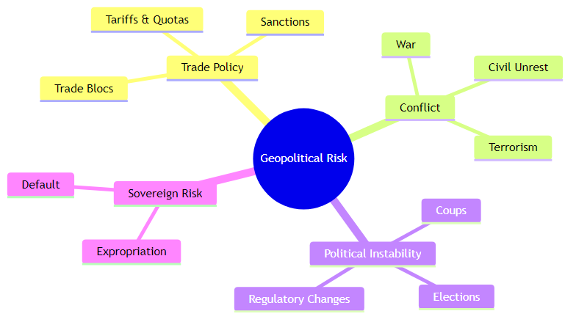
What is Geopolitical Risk?
It is the risk that political actions and events will negatively impact business operations and value. It's a broad category that has become a primary concern for boards and managers.

Slide 18
The Impact on the Firm
How does a geopolitical event in another country affect your company?
Supply Chain Disruption: A new tariff on a key input from China raises your COGS. A war in Eastern Europe halts production at a key supplier.
Market Access Loss: Sanctions on a country mean you can no longer sell your products there (zero revenue).
Asset Seizure (Expropriation): A foreign government nationalizes your factory.
Demand Shocks: Political instability in a region causes a recession, crushing consumer demand for your products.

Slide 19
Quantifying the Unquantifiable: The Country Risk Premium (CRP)
If geopolitical risk is real, it must have a price. Investors demand a higher return for taking on the risk of investing in a politically or economically unstable country. This extra return is the Country Risk Premium.
It is an additional premium added to the cost of equity for firms with significant exposure to that country.
It is estimated based on sovereign bond spreads or political risk ratings.
A company like L'Oréal (mostly in stable markets) will have a low CRP. A firm with 80% of its assets in a volatile emerging market will have a very high CRP.

Slide 20
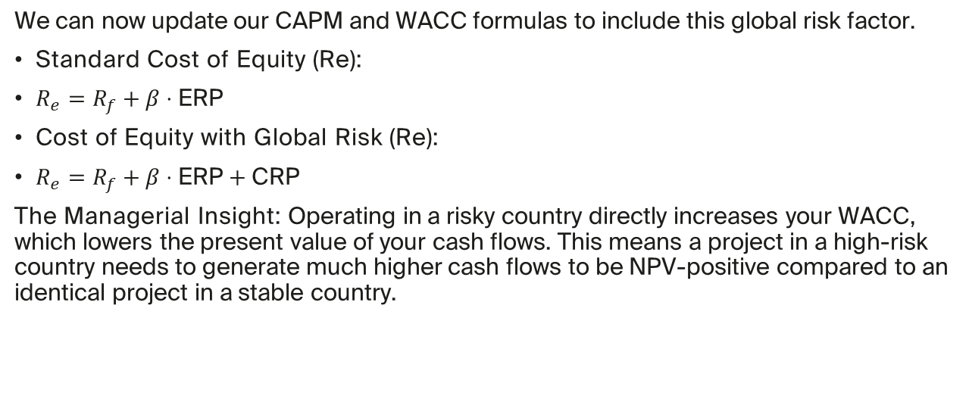
The WACC Revisited with Global Risk
We can now update our CAPM and WACC formulas to include this global risk factor.
Standard Cost of Equity (Re):
$R_{e}=R_{f}+β⋅\text{ERP}$
Cost of Equity with Global Risk (Re):
$R_{e}=R_{f}+β⋅\text{ERP}+\text{CRP}$
The Managerial Insight: Operating in a risky country directly increases your WACC, which lowers the present value of your cash flows. This means a project in a high-risk country needs to generate much higher cash flows to be NPV-positive compared to an identical project in a stable country.

Slide 21
CASE:

Slide 22
Part 5: The New Strategic Landscape - Industrial Policy & Supply Chains

Slide 23
The Rise of Industrial Policy
In response to geopolitical risk (especially US-China tensions and the COVID pandemic), governments are actively intervening to reshape supply chains.
Industrial Policy: Government actions aimed at promoting specific industries or technologies deemed critical for national security or economic competitiveness.
Key Examples:
US CHIPS and Science Act: Subsidies to encourage semiconductor manufacturing in the US.
US Inflation Reduction Act (IRA): Subsidies for green energy and electric vehicle production in North America.
Impact: Creates powerful incentives (and disincentives) for firms to choose where they locate their production facilities.

Slide 24
From "Just-in-Time" to "Just-in-Case"
 | Just-in-Time (JIT) | Just-in-Case (JIC)
Primary Goal | Efficiency & Cost | Resilience & Safety
Inventory | Minimal | Higher buffer
Sourcing | Single, low-cost | Multiple, diverse
Location Focus | Global lowest cost | On-shoring, "friend-shoring"
Financial Impact | Higher margins | Lower margins, higher NWC
 | Lower NWC | but lower risk of disruption
This new environment forces a fundamental shift in supply chain strategy.
This is a direct trade-off between profitability and risk that managers must now actively make

Slide 25
CASE Apple's Supply Chain: Navigating US-China Tensions
This is the an application of today's concepts.
The Situation: Apple built one of the most efficient JIT supply chains in history, centered on China.
The Risks: US-China trade tensions, potential for conflict over Taiwan, COVID lockdowns. These are massive geopolitical risks.
The Response: Apple is now actively pursuing a "China + 1" strategy, diversifying production to Vietnam, India, and other countries.
The Managerial Trade-off: This is a "Just-in-Case" move. It increases costs and complexity (hurting margins) but makes Apple's supply chain more resilient (reducing risk). We will discuss if this is the right move for shareholders.
Case: Apple's China+1 Strategy

Slide 26
Part 6: Wrap-Up

Slide 27
Key Takeaways for Session 5
FX Risk is Two-Sided: It affects both international revenues and costs. A strong home currency is not universally "good" or "bad."
Hedging is a Strategic Choice: It's a tool to reduce volatility, not a free lunch. It exchanges uncertainty for a cost.
Geopolitical Risk Has a Price: These risks are not just qualitative concerns; they are quantified in the Country Risk Premium (CRP), which directly increases a firm's WACC and lowers its valuation.
Strategy is Adapting: The global landscape is forcing a move from pure efficiency (Just-in-Time) to a balance with resilience (Just-in-Case), a trade-off that has real financial consequences.

