Slide 1
Business Strategy & Game Theory
Nima Fazeli

Slide 2
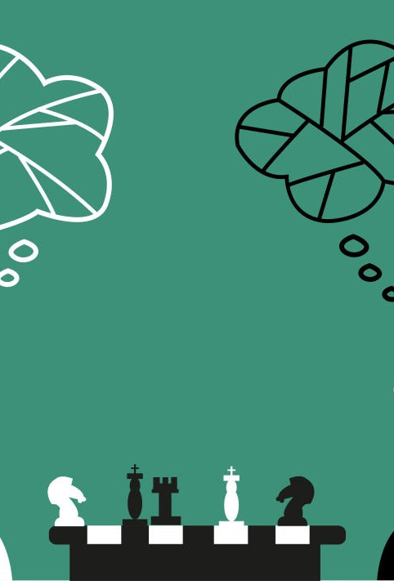
Module 1: The Prisoner's Dilemma

Slide 3
Real-World Examples of Mutually Destructive Behavior
Airline Price Wars: Two airlines on the same route repeatedly slash prices, eroding profits for both.
OPEC Production: Member countries often cheat on production quotas, causing global oil prices to fall and hurting all members.
Advertising Battles: Coca-Cola and Pepsi spend billions on advertising, much of which simply cancels the other's efforts out.

Slide 4
The Core Question
If everyone knows cooperation would be more profitable, why does it break down so often? -> Game Theory gives us a formal answer.

Slide 5
The Game Archetype: The Prisoners' Dilemma
To get a sense,
  first watch this short video: https://www.youtube.com/shorts/1OCi42lZV2M
  then the following: https://www.youtube.com/watch?v=-GWR1uO4XEI
  and now this: https://www.youtube.com/watch?v=S0qjK3TWZE8

Slide 6
The official Story
Two suspects are arrested for a crime and held in separate cells. They cannot communicate.
The police have enough evidence to convict both on a minor charge (1 year in prison).
They offer each suspect a deal, independently:
  If you Defect (confess and implicate your partner) and your partner Cooperates (stays silent), you go free, and your partner gets 10 years.
  If you both Defect, you each get 6 years.
  If you both Cooperate, you each get only 1 year on the minor charge.

Slide 7
Anatomy of a Game: Players, Actions, Payoffs
Players: Suspect 1, Suspect 2.
Actions: Each player can choose to Cooperate (Stay Silent) or Defect (Confess).
Payoffs: The years in prison for each combination of actions. We represent this in a payoff matrix.

Slide 8
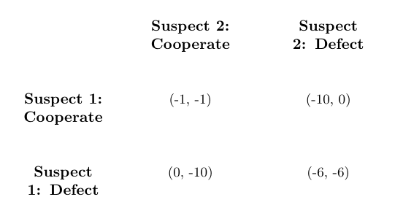
The Payoff Matrix
Payoffs are (Suspect 1, Suspect 2) and represent years in prison (lower numbers are better).

Slide 9
Solving the Game: Finding the Inevitable Outcome

Slide 10
The Concept: Dominant Strategy
A Dominant Strategy is an action that provides the best payoff for a player, regardless of what the other player does.

Slide 11
Let's Analyze for Suspect 1
If Suspect 2 Cooperates, my best move is to Defect (0 is better than -1).
If Suspect 2 Defects, my best move is also to Defect (-6 is better than -10).
Conclusion: Suspect 1 should always Defect. It is a dominant strategy.

Slide 12
Symmetry
The game is symmetric. The same logic applies to Suspect 2.
Defect is also the dominant strategy for Suspect 2.
The Inevitable Outcome: The Paradox
When all players have a dominant strategy, the outcome is an Equilibrium in Dominant Strategies.
The only logical outcome is for both players to play their dominant strategy: /(Defect, Defect)*.
The payoff is (-6, -6).

Slide 13
The Paradox of Rationality
Both players, by pursuing their own individual best interest, arrive at an outcome that is worse for both of them than if they had cooperated (-6 vs -1).
The "rational" choice leads to a "dumb" collective result. This highlights the conflict between individual rationality and collective well-being.

Slide 14
Lessons
Recognize the Pattern: Many business situations are Prisoners' Dilemmas in disguise (price wars, ad spending, trade policy). Identifying the game is the first step toward managing it.
Cooperation is Unstable: Without an enforcement mechanism, any agreement to cooperate is inherently fragile. The incentive to defect is always present for short-term gain.
Don't Expect Altruism: In a one-shot game, you cannot rely on your rival to do what is best for the group. You must assume they will act in their own best interest.
Change the Game: The key to overcoming a Prisoners' Dilemma is to change its structure. How?
  Introduce Repetition (the "shadow of the future")
  Create Enforceable Contracts (legal system)
  Cultivate Reputation
  (This is the topic of our final module!)

Slide 15

Module 2: Coordination & Brinkmanship
Cette photo par Auteur inconnu est soumise à la licence CC BY

Slide 16
Part I: The Coordination Game
The main question is: How do firms compete when they need to coordinate on a single standard to succeed?

Slide 17
The Business Problem: Wars of Standards
VHS vs. Betamax, Blu-ray vs. HD-DVD, iOS vs. Android.
Two firms develop competing technologies (standards) that are incompatible.
At first, each firm prefers its own standard.
In these battles, network effects are crucial: the more people who adopt a standard, the more valuable it becomes (more movies, more apps).
Both firms and consumers are better off if everyone coordinates on a single standard.

Slide 18

VHS vs. Betamax
The graph shows the market share of VHS (by JVC) and Betamax (by Sony) over time. Despite Betamax's technical superiority, VHS ultimately dominated the market due to better marketing, longer recording times, and wider adoption by other manufacturers.

Slide 19
The Core Question
When two firms benefit from choosing the same standard, but each prefers their own, how does one emerge as the winner?

Slide 20
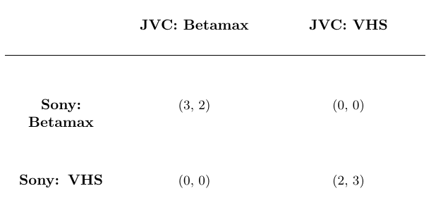
The Game Archetype: "Battle of the Sexes"
The Story: A couple wants to spend the evening together. One prefers the Opera, the other prefers the Football match. Both prefer being together over going to their preferred event alone.
We can model the standards war similarly. Let's say Sony prefers Betamax and JVC prefers VHS.

Slide 21
Solving the Game: The Equilibrium Problem
Let's find the Nash Equilibria using Best Responses.
  If JVC commits to VHS, what is Sony's best response? -> VHS. (Payoff of 2 is better than 0).
  If JVC commits to Betamax, what is Sony's best response? -> Betamax. (Payoff of 3 is better than 0).
The game is symmetric. JVC's logic is the same.
This game has TWO Nash Equilibria: (Betamax, Betamax) and (VHS, VHS).
The Strategic Problem: Both are stable outcomes. The game itself doesn't tell us which one will be played. The winner is the one who can successfully coordinate market expectations around their preferred standard.

Slide 22
Strategic Lessons: Winning a Coordination Game
Create a Focal Point: Make your standard the obvious choice. A major launch event, an exclusive deal with a key content provider (e.g., a movie studio), or a partnership with a major retailer can coordinate expectations.
Commit Credibly: Move first and make your decision irreversible. JVC licensed the VHS patent to multiple manufacturers (Hitachi, Mitsubishi), making it impossible for them to switch to Betamax. This signaled their commitment to the market.
The Market Can "Tip": In a standards war, a small initial advantage in market share can create a self-reinforcing feedback loop that leads to total market dominance. The goal is to get that small lead.

Slide 23
Part II: The Brinkmanship Game or "who will chicken out first?"
A different strategic situation arises when two firms benefit from not matching actions.
That is, each firm wants to do the opposite of what the other does.
In such cases, the game is one of brinkmanship or a "Game of Chicken."

Slide 24
The Business Problem: Market Entry & Price Wars
Consider the following scenario:
A new low-cost airline is considering entering a profitable route dominated by an incumbent (e.g., Air France).
Air France can threaten to start a devastating price war if the new airline enters.
The entrant knows that a price war would hurt Air France's profits as well.

Slide 25
The Core Question
Do you enter if the incumbent threatens to fight? How do you make your rival "blink"?

Slide 26
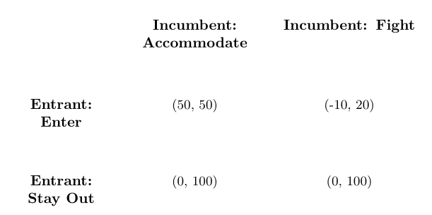
The Game Archetype: "Game of Chicken"
The Story: Two drivers speed towards each other. If one swerves, he is the "chicken," but the other wins. If both swerve, it's a draw. If neither swerves, they crash in a disaster.

Slide 27
Solving the Game: The Anti-Coordination Problem
Again, we find the Nash Equilibria using Best Responses.
  If Incumbent Accommodates, Entrant's best response is to Enter. (50 > 0).
  If Incumbent Fights, Entrant's best response is to Stay Out. (0 > -10).
From the Incumbent's perspective (if the Entrant enters):
  If Entrant Enters, Incumbent's best response is to Accommodate. (50 > 20).
This game also has TWO Nash Equilibria: (Enter, Accommodate) and (Stay Out, Fight).
The Strategic Problem: The "Fight" part of the (Stay Out, Fight) equilibrium is based on a non-credible threat. If the entrant actually enters, it's not in the incumbent's best interest to fight. The entrant must call the incumbent's bluff.

Slide 28
Strategic Lessons: Winning a Game of Chicken
Reputation is a Weapon: If an incumbent is known to be "irrational" or "aggressive" and has fought entrants on other routes (even when it was costly), their threat becomes credible. A reputation for toughness can be a valuable strategic asset.
Make Your Commitment Visible & Irreversible: A classic tactic is to "burn the ships" or "throw away the steering wheel." Before entering, the new airline could sign binding, non-refundable contracts for gate leases and launch a massive, pre-paid advertising campaign. This signals they cannot back out, forcing the incumbent to accommodate.
Limit Your Own Options: By removing your own option to retreat, you can force your rival's hand. This is the essence of brinkmanship.

Slide 29
Module 2: Key Takeaways
Many business situations have multiple possible outcomes (equilibria). Your job is not just to play the game, but to steer it towards the outcome you prefer.
First, diagnose the game:
  Is it a Coordination game? (I win if we match actions, e.g., standards).
  Is it a Brinkmanship game? (I win if we mis-match actions, e.g., entry).
In both games, the path to winning is managing your rival's expectations. You do this by establishing credible commitment to your intended action, either through reputation or by making your move irreversible.

Slide 30

Module 3: Sequential Games & The Power of Commitment

Slide 31
The Business Problem: Credible Threats
A new low-cost airline (e.g., easyJet) is considering entering a profitable route dominated by an incumbent (e.g., Air France).
Air France publicly states it will "vigorously defend its market share" and threatens to slash prices, starting a devastating price war, if easyJet enters.
The entrant (easyJet) knows that a price war would also severely damage Air France's profits on that route.

Slide 32
The Core Question
How should the entrant assess the incumbent's threat? When is a threat (or a promise) credible?
-> Game Theory allows us to distinguish cheap talk from credible commitment.

Slide 33
The Game Archetype: The Sequential Entry Game
We model this as a sequential game, where one player moves first, and the other observes and then reacts.
The best way to visualize this is with a Game Tree.
Players: Entrant (E), Incumbent (I).
Sequence:
  Entrant chooses to Enter or Stay Out.
  If Entrant Stays Out, the game ends.
  If Entrant Enters, the Incumbent observes this and then chooses to Accommodate or Fight (Price War).
Payoffs: Profits in millions of euros, shown as (Entrant, Incumbent).

Slide 34
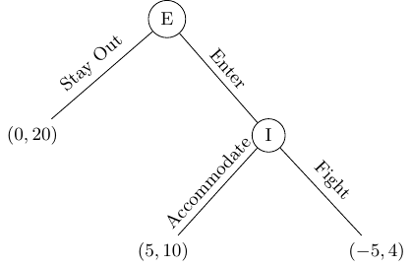
The Game Archetype: The Sequential Entry Game

Slide 35
Solving the Game: Backward Induction
To solve a sequential game, we use Backward Induction: a method of "looking forward and reasoning back."
We start at the end of the game and work our way to the beginning.

Slide 36
Step 1: Analyze the Incumbent's Move
Start at the final decision node (Incumbent's choice).
If the Entrant has already entered, what is the Incumbent's rational move?
  Accommodate -> Payoff is /10M€*.
  Fight -> Payoff is /4M€*.
Since 10 > 4, the Incumbent will always Accommodate if the Entrant enters.
The threat to Fight is a non-credible threat. It is irrational for the incumbent to carry it out once entry has occurred.

Slide 37
Step 2: Analyze the Entrant's Move
The Entrant, reasoning forward, anticipates the Incumbent's rational reaction.
If I Stay Out, my payoff is 0M€.
If I Enter, I know the Incumbent will Accommodate, so my payoff will be 5M€.
Since 5 > 0, the Entrant chooses to Enter.

Slide 38
The Inevitable Outcome: The SPNE
The unique Subgame Perfect Nash Equilibrium (SPNE) is (Enter, Accommodate).
The incumbent's threat is just cheap talk. The entrant should call the bluff.

Slide 39
Changing the Game: The Power of Commitment
The incumbent is not happy with this outcome. How can they credibly commit to fighting?
They must change the payoffs of the game before it begins, making it rational for them to fight.

Slide 40
How to Build Credible Commitment
Invest in Excess Capacity: If the incumbent sinks costs into building a huge factory or a massive fleet, their marginal cost of producing more drops. A price war becomes less costly for them, making the threat to fight more credible.
Build a Reputation: If an incumbent is known to be "tough" or "aggressive" and has fought entrants in other markets (even when it was costly), their threat becomes credible. Reputation is a strategic asset.
"Burn the Ships": By taking an action that makes retreat impossible, you signal your commitment. The incumbent could sign binding contracts that penalize them for not fighting, or publicly stake their professional reputation on driving the entrant out.
Let's see how a reputation for "toughness" changes the game. If the Incumbent accommodates, they suffer a "reputation loss" of -8M€.

Slide 41
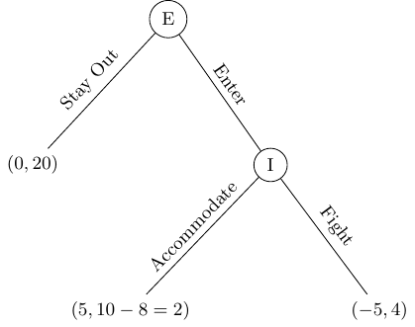
How to Build Credible Commitment

Slide 42
How to Build Credible Commitment
New Backward Induction:
  Incumbent's Move: If Entrant enters, fighting (4M€) is now better than accommodating (2M€). The threat is now credible.
  Entrant's Move: The Entrant anticipates being fought. Entering gives -5M€, Staying Out gives 0M€. The Entrant will Stay Out.
By investing in commitment, the incumbent has successfully deterred entry.

Slide 43
Module 3: Strategic Lessons
Threats are cheap, commitment is not. A threat is only credible if it is in your rival's self-interest to carry it out at the moment of action. Analyze threats based on incentives, not words.
Look Forward, Reason Back. When facing a sequence of moves, always use backward induction to anticipate the rational path of play. Don't be fooled by non-credible threats.
Change the Game by Changing Payoffs. The key to winning is often not just playing the game well, but actively shaping the game's structure before it begins. Commitment devices are your tools for this.
Your Reputation is a Strategic Asset. In repeated interactions, your past actions create your reputation, which makes future threats and promises credible. Protect it.

Slide 44

Module 4: The Long Game: Building Trust & Reputation in a World of Rivals

Slide 45
The Puzzle of Tacit Collusion
We know from the Prisoners' Dilemma that in a one-shot game, two competing firms have an incentive to slash prices.
Yet, in the real world, we often see stable, high prices even with no explicit agreement.
  Why do competing gas stations on the same street corner often have identical, high prices?
  Why don't airlines on a given route engage in a price war every single day?
The answer lies not in playing the game once, but in playing it over and over.

Slide 46
The "Shadow of the Future"
The one-shot Prisoners' Dilemma is pathologically pessimistic. Most business relationships aren't one-night stands; they are long-term engagements.
When players know they will interact again tomorrow, their behavior today changes.
The prospect of future rewards (from continued cooperation) and future punishments (from retaliation) can discipline behavior today.
This is the "Shadow of the Future": the future casts a shadow on the present, influencing a player's strategic choices.

Slide 47
A Strategy for Cooperation: Tit-for-Tat
In a repeated game, a "strategy" is no longer a single action, but a complete rule for how to act based on the history of the game.
The most famous and successful strategy is Tit-for-Tat. Its rules are simple:
  Start by Cooperating on the first move.
  In all subsequent moves, do whatever your opponent did in the previous move.
If they cooperate, you cooperate. If they defect, you defect. You are a mirror.

Slide 48
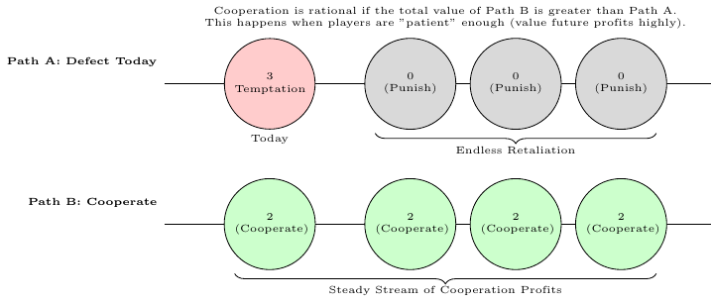
The Logic of Sustaining Cooperation
A rational player will only cooperate if the long-term benefit of mutual cooperation outweighs the short-term gain from cheating.

Slide 49
The emergence of cooperation
Evidence: Robert Axelrod's Tournament
In the 1980s, political scientist Robert Axelrod hosted a computer tournament to find the best strategy for the repeated Prisoners' Dilemma.
Academics and programmers submitted strategies ranging from highly complex to very simple.
The surprising winner was Tit-for-Tat, one of the simplest algorithms submitted.
The key insight: Successful strategies were not complex or exploitative. They shared a handful of key characteristics.

Slide 50
Lesson 1: Be Nice
Lesson 1: Be Nice
Never be the first to defect.
This is the most important characteristic of the top-performing strategies.
Starting cooperatively immediately signals your intent and allows trust to be built.
In business terms: Don't start a price war. Don't launch a negative ad campaign unprovoked. Give your rival the benefit of the doubt, at least initially.
A "Nice" strategy can never finish with a score lower than its opponent.

Slide 51
Lesson 2: Be Provocable
Lesson 2: Be Provocable
Retaliate immediately to a defection.
A strategy that is too forgiving will be relentlessly exploited by aggressive rivals.
If a rival defects (e.g., cuts prices), you must respond in kind immediately. This teaches them that defection does not pay.
The retaliation should be proportional. The goal is not to destroy the rival, but to train them to return to cooperation.
This establishes your credibility and demonstrates that you will not be taken for a fool.

Slide 52
Lesson 3: Be Forgiving
Lesson 3: Be Forgiving
After retaliating, be willing to restore cooperation.
A cycle of endless revenge is mutually destructive.
After a Tit-for-Tat retaliation, if the rival returns to cooperation, you must immediately forgive them and cooperate as well.
This prevents long, costly feuds and allows the relationship to get back on the profitable, cooperative track.
Don't hold grudges. The goal is future profit, not past revenge.

Slide 53
Lesson 4: Don't Be Too Clever (Be Clear)
Lesson 4: Don't Be Too Clever (Be Clear)
*Your strategy should be simple and easy for your rival to understand.
A complex, "unpredictable" strategy is a liability. If your rival can't figure out your pattern, they can't learn to cooperate with you.
They may misinterpret your actions as random and hostile, leading to a breakdown of trust.
Tit-for-Tat's success comes from its clarity. The rival quickly learns the "rules of engagement": if I cooperate, they cooperate; if I defect, they defect.
Clarity is a strategic asset. It makes you a reliable partner for cooperation.

Slide 54
Module 4: Strategic Takeaways
Module 4: Strategic Takeaways
The Future Matters: The prospect of future interaction is the most powerful force for sustaining cooperation. Your long-term strategy must account for this.
Reputation is an Asset: Your actions build a reputation. A reputation for being trustworthy, but not a pushover, is incredibly valuable. Your rivals will learn how to interact with you based on your past behavior.
Train Your Rivals: Through a clear and consistent strategy (Nice, Provocable, Forgiving), you can teach your competitors that cooperation is the most profitable path for everyone.
Simplicity is Strength: In strategic interactions, clarity trumps cleverness. Ensure your rivals understand what you will do and why.

Slide 55
A youtube video
A fantastic video summarizing the key concepts of Game Theory and showcasing Axelrod's tournament:
https://www.youtube.com/watch?v=mScpHTIi-kM

