Slide 1
Session 1: The Modern Analyst's Toolkit
Nima Fazeli

Slide 2
Session 1: The Modern Analyst's Toolkit
Agenda
The "Why": The role of technology in modern finance.
The Stack: Key tools you will encounter.
Our Focus: Python and Google Colab.
Python Fundamentals: Variables, Lists, Dictionaries.
Introduction to pandas for data handling.
Hands-on Activity: First steps in financial analysis.

Slide 3
The "Why": Beyond Excel
Finance is no longer just about spreadsheets. Today's competitive edge comes from:
Automation: Automating repetitive data gathering and reporting.
Scale: Analyzing datasets too large for Excel.
Advanced Analytics: Applying statistical and AI models.
Reproducibility: Creating verifiable and repeatable analysis.
This course is about building these skills.

Slide 4
The Analyst's Tech Stack
Tool | Primary Use Case
Excel | Quick analysis, dashboards, client reports
Bloomberg | Real-time data, market news, analytics
Python | Data analysis, automation, modeling, APIs
AI Tools | Code generation, text summary, insight
A quick overview of the tools shaping the industry:
Our goal is to learn how to make them work together.

Slide 5
Environment: Google Colab & Python
We will use Google Colab to write Python.
Why?
  No installation required; it runs in your browser.
  Comes with major libraries (pandas, matplotlib) pre-installed.
  Easy to save and share your work.
Python: A versatile, readable programming language. Its power in finance comes from its extensive libraries.

Slide 6
Python Fundamentals: Variables
Variables store data.
stock_ticker = "AAPL" # A string
last_price = 175.50 # A float (decimal number)
volume = 95_000_000 # An integer (underscores are for readability)
print(f"Ticker: {stock_ticker}, Price: ${last_price}")
Ticker: AAPL, Price: $175.5

Slide 7
Python Fundamentals: Lists & Dictionaries
Lists: Ordered collections of items.
Dictionaries: Unordered collections of key-value pairs.
# A list of tech stock tickers
tech_tickers = ["AAPL", "GOOGL", "MSFT", "NVDA"]
print(f"First ticker in list: {tech_tickers[0]}")
# A dictionary with info about one stock
stock_info = {
"ticker": "LVMH",
"exchange": "Paris",
"sector": "Consumer Cyclical"
}
print(f"LVMH Sector: {stock_info['sector']}")
First ticker in list: AAPL
LVMH Sector: Consumer Cyclical

Slide 8
The Core Library: pandas
pandas is the most important Python library for data manipulation. It introduces two key structures:
Series: A one-dimensional labeled array (like a single column in Excel).
DataFrame: A two-dimensional table with labeled rows and columns (like an entire Excel sheet).
Almost all tabular data analysis in Python is done with pandas DataFrames.

Slide 9
Activity: Financial Analysis in Python
We will perform three steps:
Load financial data from a local file.
Calculate daily percentage returns.
Compute basic descriptive statistics.
First, let's use a sample data file named data.csv.
Date,Price
2023-10-01,150.5
2023-10-02,152.0
2023-10-03,151.8
2023-10-04,153.2
2023-10-05,152.9

Slide 10
Activity 1: Load Data with pandas
We use pd.read_csv() to load the file into a DataFrame.
import pandas as pd
# Load the data, parsing dates correctly
df = pd.read_csv('data.csv', parse_dates=['Date'], index_col='Date')
print(df)
Price
Date
2023-10-01 150.5
2023-10-02 152.0
2023-10-03 151.8
2023-10-04 153.2
2023-10-05 152.9

Slide 11
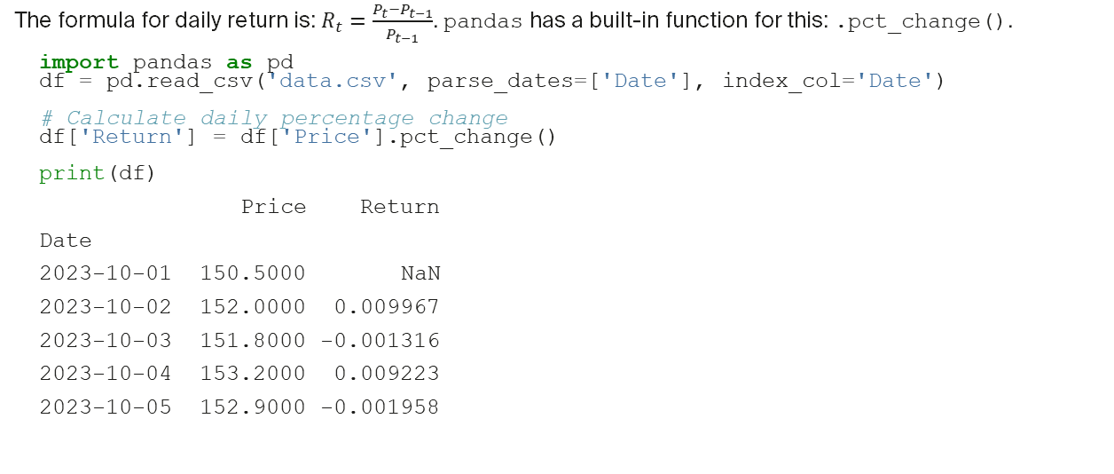
Activity 2: Calculate Daily Returns
The formula for daily return is: $R_{t}=\frac{P_{t}−P_{t−1}}{P_{t−1}}$. pandas has a built-in function for this: .pct_change().
import pandas as pd
df = pd.read_csv('data.csv', parse_dates=['Date'], index_col='Date')
# Calculate daily percentage change
df['Return'] = df['Price'].pct_change()
print(df)
Price Return
Date
2023-10-01 150.5000 NaN
2023-10-02 152.0000 0.009967
2023-10-03 151.8000 -0.001316
2023-10-04 153.2000 0.009223
2023-10-05 152.9000 -0.001958

Slide 12
Activity 3: Compute Basic Statistics
The .describe() method provides a quick statistical summary of the data.
import pandas as pd
df = pd.read_csv('data.csv', parse_dates=['Date'], index_col='Date')
df['Return'] = df['Price'].pct_change()
# Get summary statistics for the 'Return' column
return_stats = df['Return'].describe()
print(return_stats)
count 4.000000
mean 0.003979
std 0.006240
min -0.001958
25% -0.001476
50% 0.003954
75% 0.009409
max 0.009967
Name: Return, dtype: float64

Slide 13
Recap & Next Steps
Today we:
Discussed the modern finance tech stack.
Introduced Python and the pandas library.
Loaded data, calculated returns, and generated statistics.
Next Session:
Data Analysis & Visualization in Python
We will download real stock data and create plots with matplotlib.

