Slide 1
Session 2: Data Analysis & Visualization in Python
Nima Fazeli

Slide 2
Recap of Session 1
Introduced Python, Google Colab, and the pandas library.
Learned about variables, lists, and dictionaries.
Loaded data from a local CSV file into a pandas DataFrame.
Calculated daily returns using .pct_change().
The DataFrame is our primary tool for handling tabular data.

Slide 3
Today's Agenda
Sourcing real, live financial data using the yfinance library.
Time-series analysis: Calculating moving averages to identify trends.
Introduction to data visualization with matplotlib.
Activity: Download stock data, calculate moving averages, and plot a classic technical indicator chart.

Slide 4
Sourcing Real Financial Data with yfinance
We can't always rely on local CSV files. We need to access live market data. The yfinance library offers a simple way to download historical data from Yahoo Finance.
First, let's install it. In Google Colab, you run shell commands by prefixing them with !.
pip install yfinance
Now let's download data for LVMH (ticker MC.PA on the Paris exchange).
import yfinance as yf # Download historical data for LVMH data = yf.download("MC.PA", start="2023-01-01", end="2024-01-01") print(data.tail()) # Display the last 5 rows

Slide 5
Time-Series Analysis: Moving Averages
A Simple Moving Average (SMA) is a core technical analysis tool that smooths out price data to help identify the direction of the trend.
It's calculated by averaging the closing price over a specific number of periods (e.g., 50 days, 200 days).
pandas makes this easy with the .rolling() method. # Let's use a longer history for meaningful averages data = yf.download("MC.PA", start="2022-01-01", end="2024-01-01") # Calculate 50-day and 200-day Simple Moving Averages data['SMA50'] = data['Close'].rolling(window=50).mean() data['SMA200'] = data['Close'].rolling(window=200).mean() # Display the last rows. Note the NaNs where there isn't enough data. print(data.tail())

Slide 6
Introduction to Data Visualization
"A picture is worth a thousand data points."
Visualizing data is crucial for:
Identifying trends and patterns (like our moving averages).
Spotting outliers and anomalies.
Communicating your findings effectively.
matplotlib is the foundational plotting library in Python.

Slide 7
ACTIVITY Compare stock performance with another stock
Write a code to compare LVMH with Kering (KER.PA) stock performance over the same period using their closing prices. Plot both stocks on the same graph for comparison. In order to make the comparison more meaningful, normalize the closing prices to start at 100 on the first day of the period.

Slide 8
ACTIVITY Charting Moving Average Crossovers
Let's combine everything: download data, calculate SMAs, and plot them. This is a common technical chart used to spot "Golden Cross" (bullish) and "Death Cross" (bearish) signals.

Slide 9
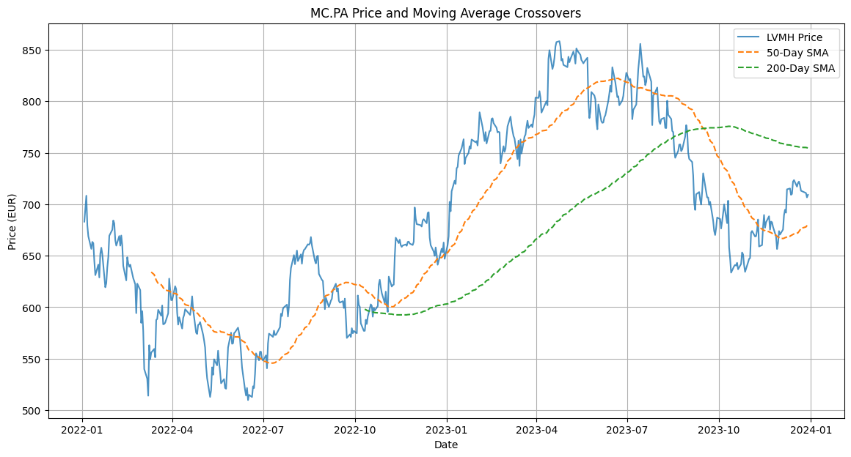
ACTIVITY Charting Moving Average Crossovers

Slide 10
ACTIVITY Calculate and Plot Rolling Volatility
Goal: Reinforce the use of `.rolling()` for a different metric (standard deviation) and plot it as a time series.
Tasks: Historical volatility is a key risk measure. Using `yfinance`, download data for BNP Paribas (`BNP.PA`) for the last two years. First, calculate the daily returns. Then, compute and plot the 30-day rolling standard deviation of these returns (this is the 30-day volatility).

Slide 11
Recap & Next Steps
Today we:
Used yfinance to download real stock data.
Performed time-series analysis with .rolling() to calculate SMAs.
Created and customized our first financial chart with matplotlib.
Next Session:
We dive into the industry standard: The Bloomberg Terminal.
We will learn key functions for equity research, economic analysis, and finding news.

