Slide 1
Session 6: Macroeconomic Strategy & Business Cycle Management
Nima Fazeli

Slide 2
Part 1: The Challenge

Slide 3
Session 6 Goals
The Key Question: How do we steer the firm through the booms and busts of the economic cycle?
Identify the phases of the business cycle.
Build a manager's dashboard using key leading economic indicators (PMI, Yield Curve).
Develop a managerial playbook for adapting strategy during expansions and recessions.
Analyze a major strategic decision at the intersection of macroeconomics, industrial policy, and geopolitics through the Intel case study.
Dedicate time to the Final Project Workshop.

Slide 4
From Analysis to Action
Macro Shock | Channels | Firm Impact
GDP Growth Slows | FCF (Revenue) | Lower Sales
Interest Rate Hike | WACC (Rf) | Higher Hurdle Rate
Inflation Spikes | FCF (Margins) | Margin Squeeze
In previous sessions, we built the "Macro-to-Value" map to understand how the economy impacts our firm.
Today, we move from analysis to action. Given these impacts, what strategic decisions should we make to protect and create value?

Slide 5
Part 2: Understanding the Business Cycle

Slide 6
What is a Business Cycle?
The economy does not grow in a straight line. It fluctuates around its long-term trend in a sequence of phases known as the business cycle.
Expansion: A period of real GDP growth. Employment, incomes, and profits rise.
Peak: The high point of the cycle, before growth turns negative.
Contraction (Recession): A period of falling real GDP. Employment, incomes, and profits fall.
Trough: The low point of the cycle, before growth turns positive again.
A manager's job is not to predict the exact timing, but to understand the current phase and prepare for the next one.

Slide 7
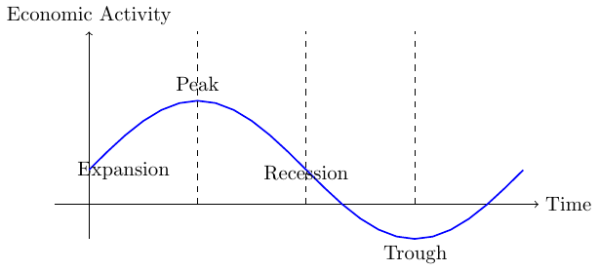
Diagram: The Four Phases of the Business Cycle

Slide 8
Leading, Lagging, and Coincident Indicators
To understand where we are in the cycle, economists use different types of indicators:
Leading Indicators: Change before the overall economy changes. They are forward-looking and essential for managers. (e.g., PMI, Yield Curve Spread, Building Permits).
Coincident Indicators: Change at roughly the same time as the overall economy. They tell us the current state. (e.g., Industrial Production, Payroll Employment).
Lagging Indicators: Change after the overall economy changes. They confirm a pattern that is already underway. (e.g., Unemployment Rate, Corporate Profits).
We will focus on the two most powerful leading indicators for managers.

Slide 9
Part 3: A Manager's Dashboard for the Business Cycle

Slide 10
Leading Indicator #1: The Yield Curve
The yield curve plots the interest rates (yields) of bonds with different maturity dates.
The spread between a long-term bond (e.g., 10-year) and a short-term bond (e.g., 3-month) is a powerful recession predictor.
Normal Curve: Long-term yields > Short-term yields. The market expects growth.
Inverted Curve: Short-term yields > Long-term yields. The market is pricing in a future slowdown and Fed rate cuts. An inverted yield curve has preceded every major US recession for the last 50 years.

Slide 11
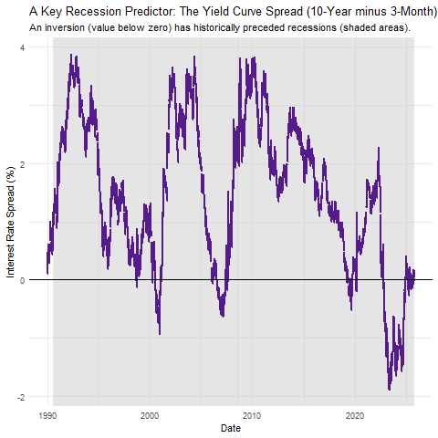
Live Data: The 10-Year / 3-Month Spread
Let's pull the data. When the line goes below zero, the curve is inverted. Shaded areas are recessions.

Slide 12
Leading Indicator #2: The PMI Index
The Purchasing Managers' Index (PMI) is a survey-based indicator of business activity. Managers are asked about new orders, production, employment, etc.
It is a diffusion index. A reading > 50 indicates expansion. A reading < 50 indicates contraction.
It provides a real-time signal of the health of the manufacturing and services sectors, often before official GDP data is released.
You can get PMI data from the Institute for Supply Management (ISM) website

Slide 13
Leading Indicator #3: Nowcasts
What is a "Nowcast"?
A real-time estimate of current economic activity using high-frequency data.
Useful because official GDP data is released with a lag (monthly or quarterly).
Examples of Nowcast providers:
Bloomberg (BECO MODELS function on Bloomberg Terminal)
Cleveland Fed Nowcast of Inflation
New York Fed Nowcast
Atlanta fed GDPNow (GDPNow) and their EconomyNow App

Slide 14
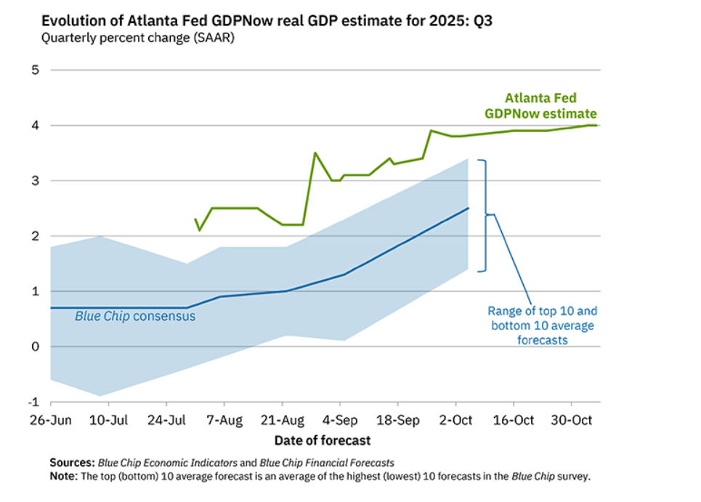
Leading Indicator #3: Nowcasts

Slide 15
ACTIVITY Interpreting the PMI Data
Setup:
Split into groups: You belong to the management team of either of the following companies:
  A global industrial machinery manufacturer like Caterpillar or John Deere.
  A consumer goods company with significant retail exposure like Procter & Gamble or Unilever.
  A transportation and logistics firm like FedEx or UPS.
Task:
Get the latest US Manufacturing PMI data from the ISM website.
Read the report summary and note the current PMI value.
Discuss with your group: Based on the PMI reading, what phase of the business cycle do you think the economy is currently in? What implications does this have for your company's strategy?

Slide 16
Live Data: Other useful indicators publicly available
Beyond PMI, other leading indicators include:
Building Permits: Indicates future construction activity.
Consumer Confidence Index (CCI): Measures consumer sentiment about the economy.
Initial Jobless Claims: Weekly data on new unemployment claims, signaling labor market health.
Industrial Production Index: Measures output of factories, mines, and utilities.
These can be found on the FRED website. The drawback is that most of these data are focusing on the US.

Slide 17
Part 4: The Managerial Playbook

Slide 18
Strategic Posture Through the Cycle
Phase | Macro Environment | The Playbook
Early Expansion / Boom | Growth accelerating, rates still low Confidence high | - INVEST: Aggressively fund positive-NPV projects. - HIRE: Secure talent before the labor market gets too tight. - FINANCE: Consider locking in long-term debt before rates rise.
Late Expansion / Peak | Growth slowing, inflation rises, yield curve starts to flatten/invert | - DE-RISK: Strengthen the balance sheet. Pay down variable-rate debt. - PLAN: Begin scenario planning for a downturn. Identify discretionary costs to cut. - MANAGE NWC: Tighten credit terms, reduce excess inventory.
Contraction / Recession | GDP falling, unemployment rising PMI < 50, rates falling | - PRESERVE CASH: Execute cost-cutting plans. Defer non-essential capex. - COMMUNICATE: Manage investor and employee expectations proactively. - BE OPPORTUNISTIC: Look for distressed assets or competitors to acquire if your balance sheet is strong.
Early Recovery / Trough | Growth turns positive but is fragile Confidence slowly returns | - RE-INVEST: Cautiously restart hiring and investment in core areas. - RE-FINANCE: Take advantage of low interest rates to refinance expensive debt.
Knowing where you are in the cycle is useless without a plan. A robust firm adapts its financial and operational strategy to the changing environment.

Slide 19
Part 5: Case Study - Intel's Big Bet

Slide 20
CASE Intel's Big Bet: The CHIPS Act and Global Foundry Strategy
We will now move to the case study you have in PSBLearn. This case is the perfect embodiment of today's themes.
It's a massive, long-term strategic decision ($100B+ in capex).
It is being made in a highly cyclical industry (semiconductors).
It is directly influenced by geopolitics (US-China) and industrial policy (the CHIPS Act).
It forces management to make a choice that must be profitable through multiple business cycles.

Slide 21
(Discussion of the Intel Case)

Slide 22
Part 6: Final Project Workshop

Slide 23
WORKSHOP Final Project Workshop
Objective: To provide dedicated time for your groups to advance your final project analysis and receive instructor feedback.
Task: In your project groups, work on the following checklist. Be prepared to discuss your progress.
Company & Thesis: Have you finalized your company choice? What is your core thesis about its macro exposure?
Macro-to-Value Map: Have you built a specific map for your company, identifying the 3-4 most critical macro drivers for its FCF and WACC?
Data Gathering Plan: Which specific data series (from FRED, etc.) will you use to track these variables?
Scenario Definition: Start outlining your 2-3 macro scenarios (e.g., "Hard Landing," "Persistent Inflation"). What would the yield curve, PMI, and inflation look like in each?
Division of Labor: Who is responsible for what part of the analysis?

Slide 24
Session 6 Key Takeaways
Cycles are Inevitable: The economy moves in cycles. The best managers don't fight the cycle; they anticipate and adapt to it.
Build Your Dashboard: A few key leading indicators like the Yield Curve and PMI can provide powerful, early warnings about the direction of the economy.
Have a Playbook: Your financial and operational strategy should not be static. It must adapt to the different phases of the business cycle to manage risk and seize opportunities.
Strategy is Long-Term: The biggest strategic decisions (like Intel's) must be robust enough to succeed across multiple business cycles and account for the new realities of geopolitics and industrial policy.

